Slide 1
Starting a Hackerspace

Slide 2
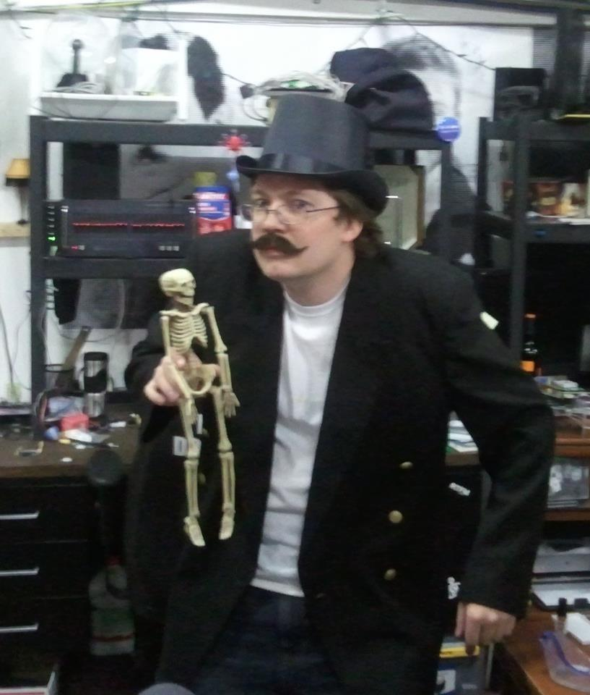
Who am I?
d3c4f

Slide 3
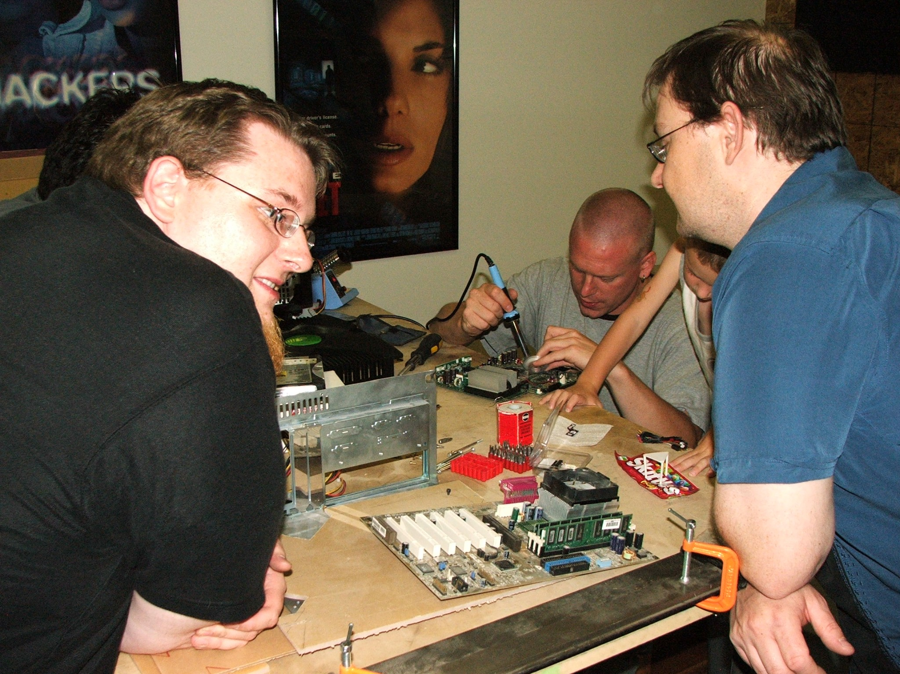
Founder of HackSLC (2009)

Slide 4
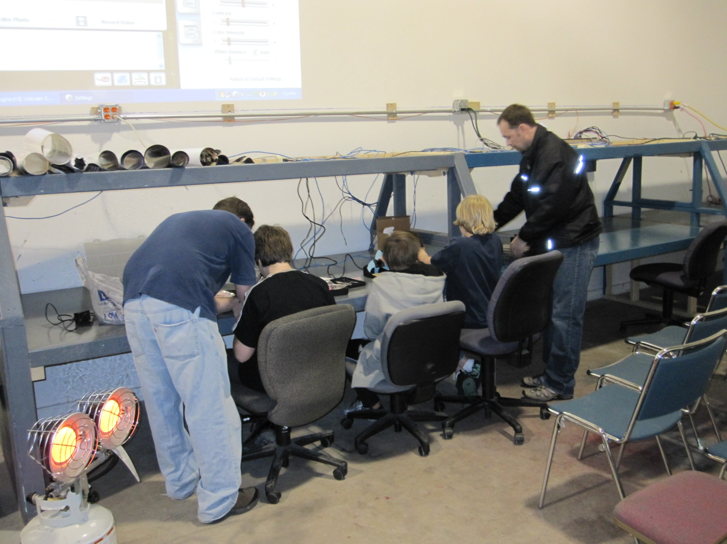
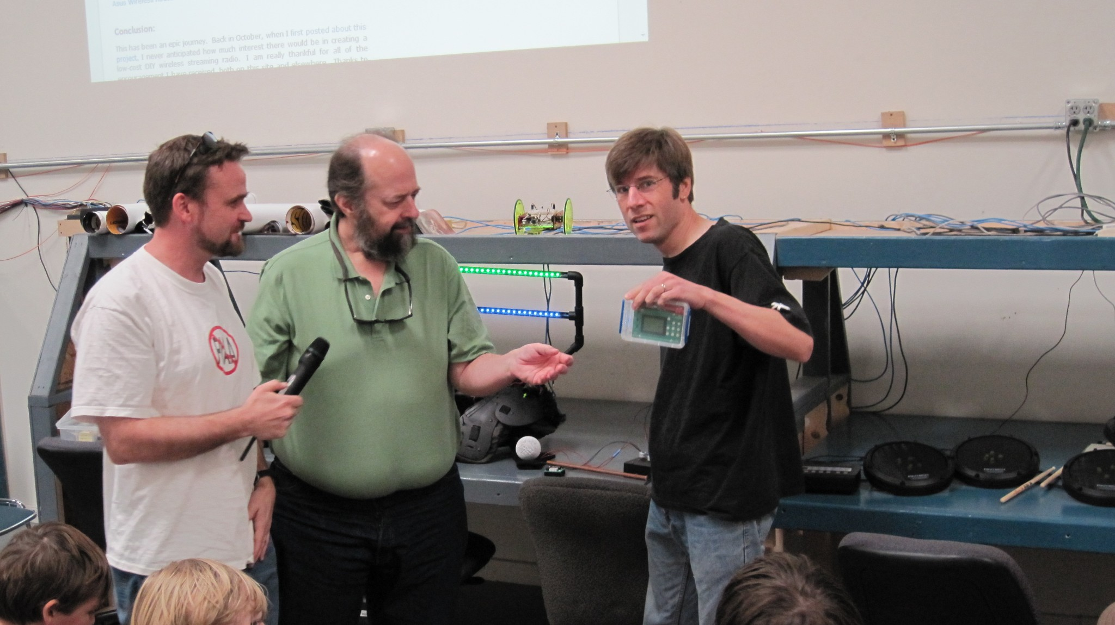
Founding Sponsor
MakeSLC (2009)

Slide 5
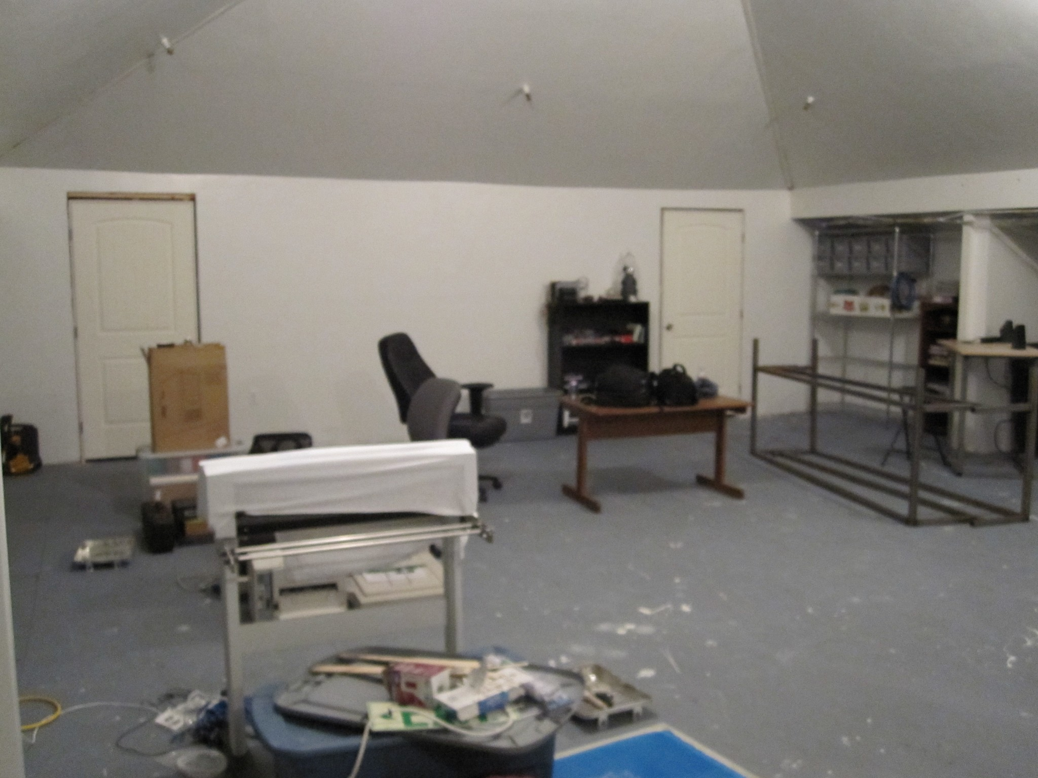
Founder of TheTransistor (2010)

Slide 6
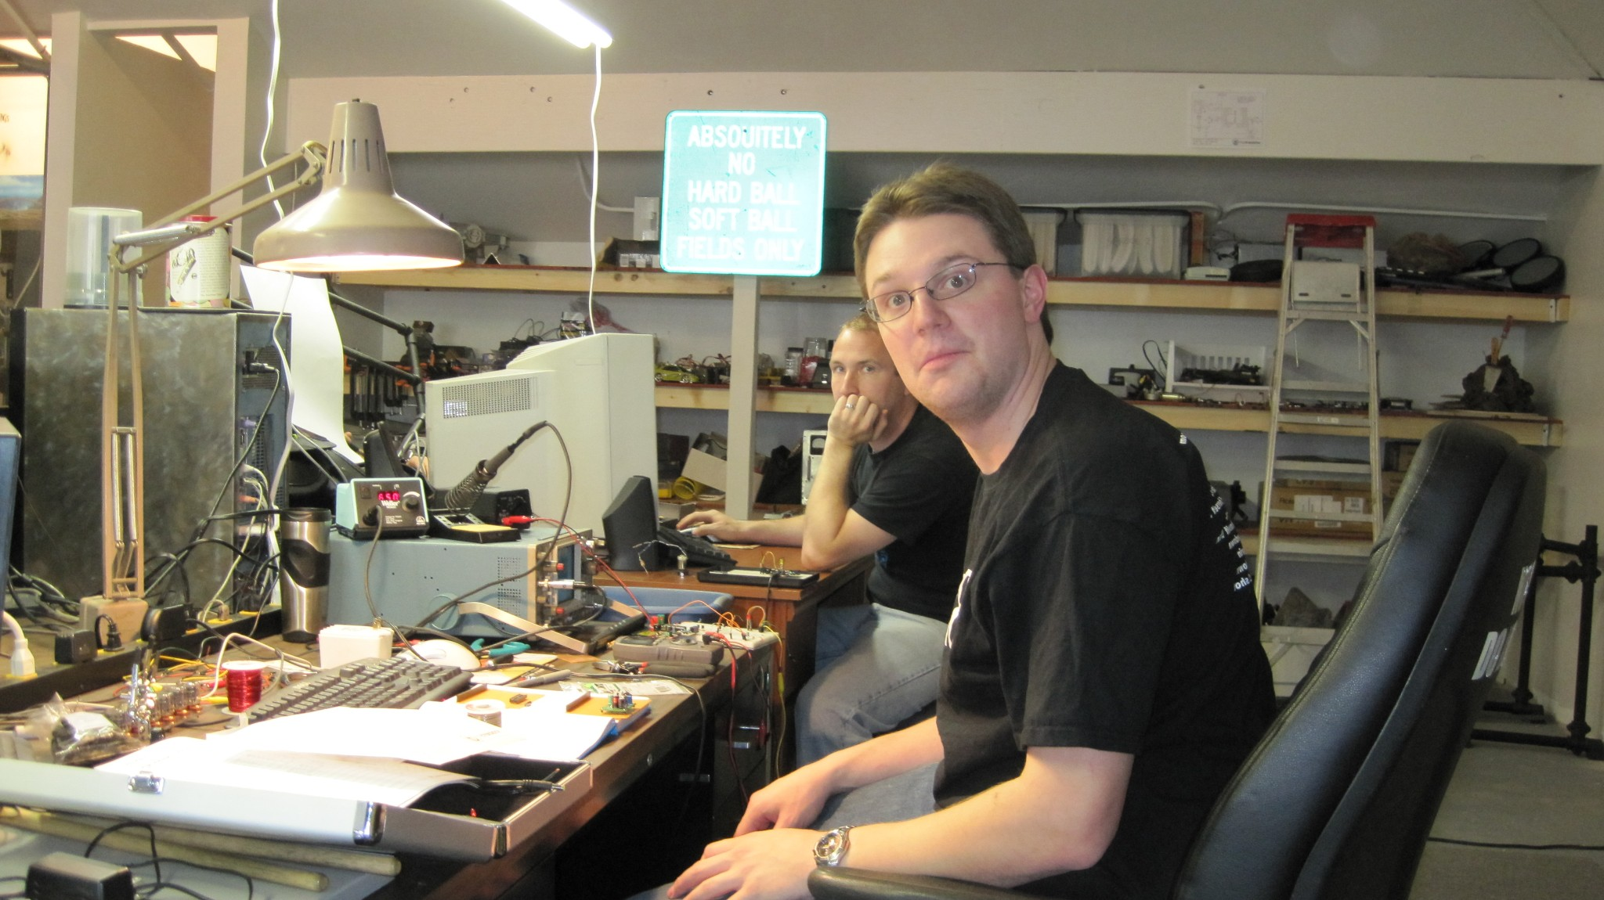

Slide 7
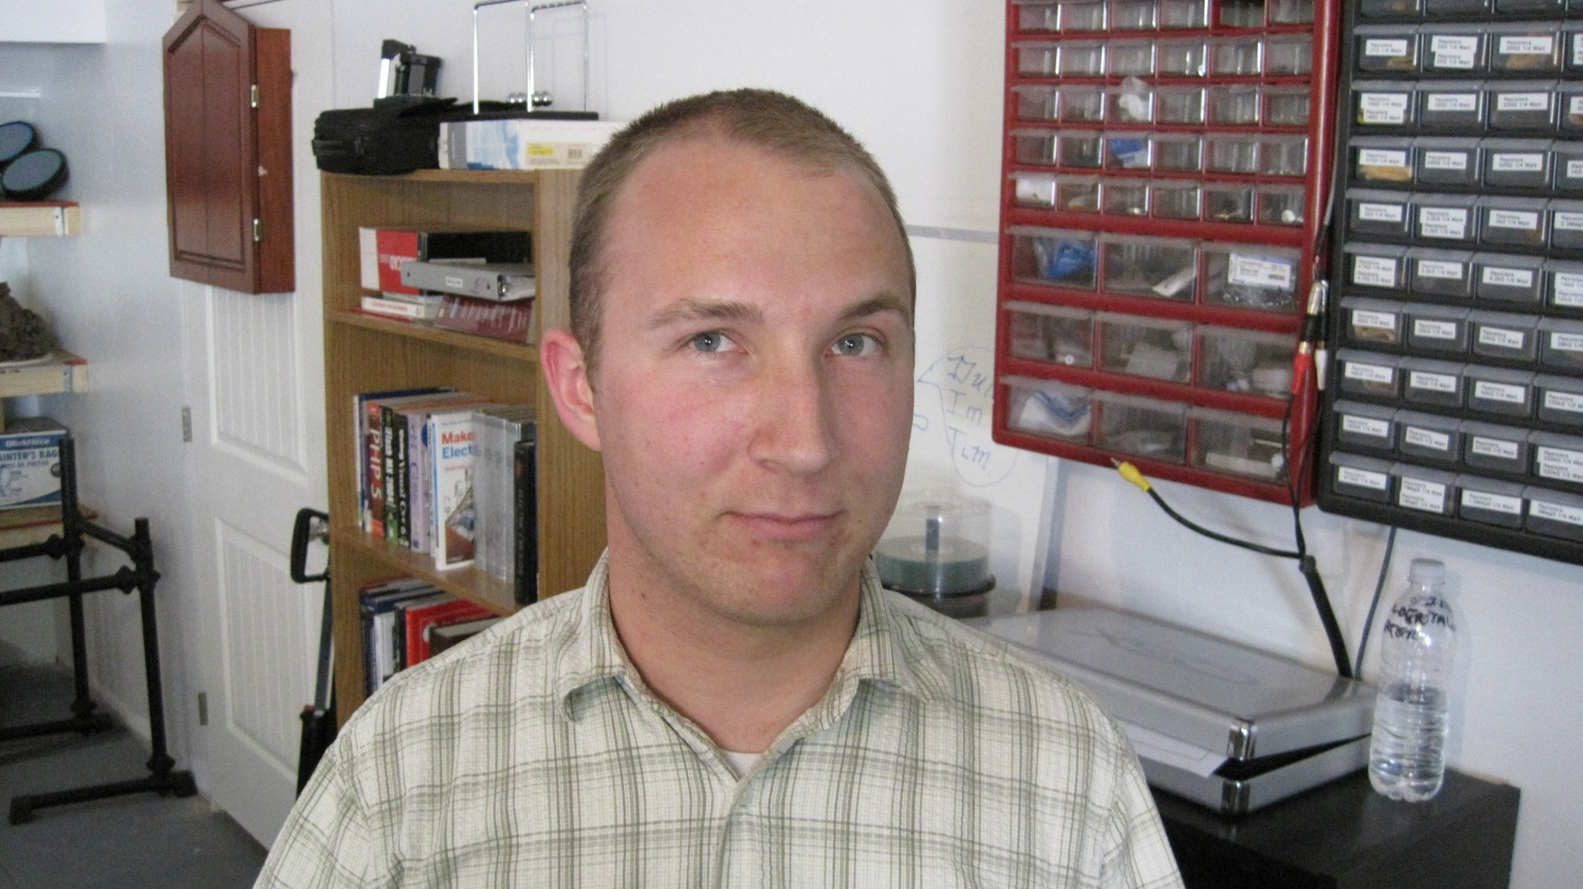

Slide 8
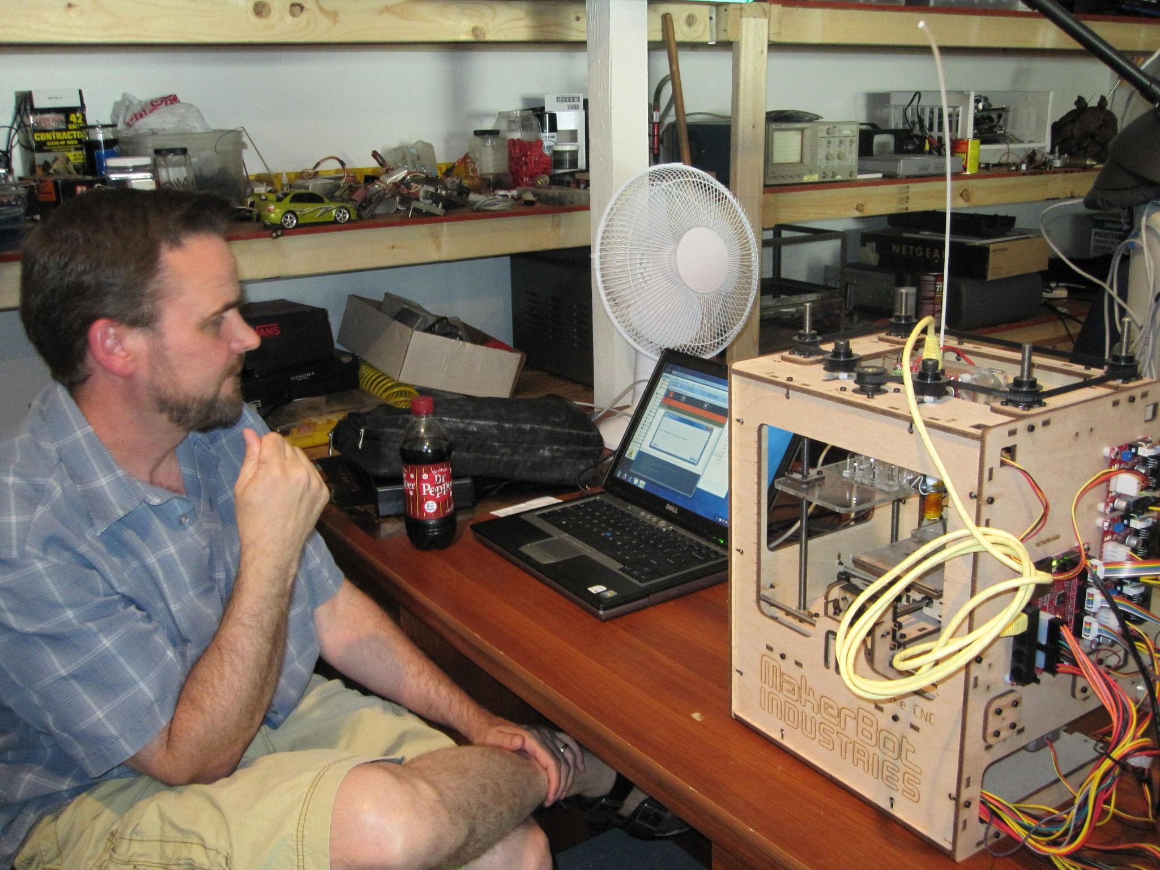

Slide 9
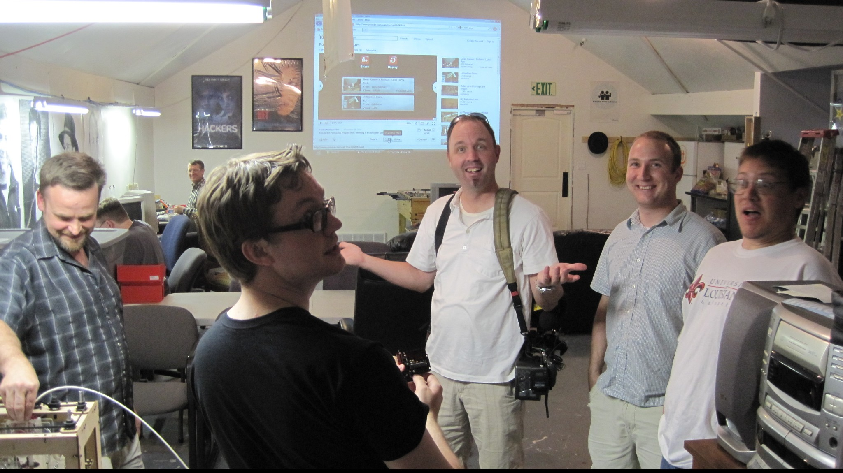

Slide 10
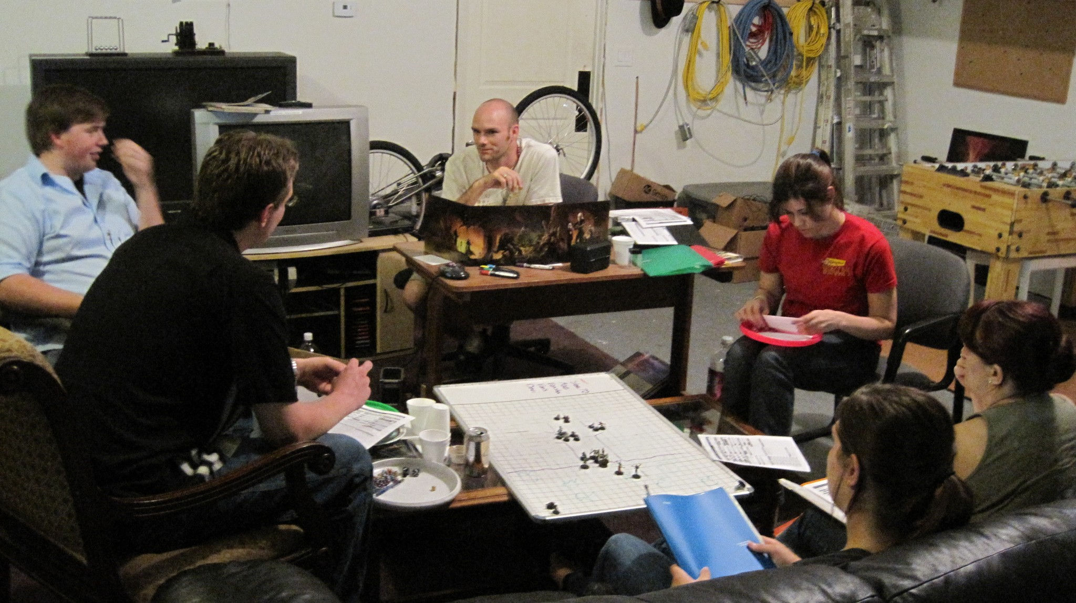

Slide 11
What is a hackerspace and why would you possibly want to start one?

Slide 12

What is a hackerspace and why would you possibly want to start one?
Hackerspaces.org -
"Hackerspaces are community-operated physical places, where people can meet and work on their projects."

Slide 13
What is a hackerspace and why would you possibly want to start one?
Wikipedia.org -
"A hackerspace or hackspace (also referred to as a hacklab, makerspace or creative space) is a location where people with common interests, often in computers, technology, science, digital or electronic art (but also in many other realms) can meet, socialise and/or collaborate. Hackerspaces can be viewed as open community labs incorporating elements of machine shops, workshops and/or studios where hackers can come together to share resources and knowledge to build and make things.
Many hackerspaces participate in the use and development of free software, open hardware, and alternative media. They are often physically located in infoshops, social centers, adult education centers, or on university campuses, but may relocate to industrial or warehouse space when they need more room."

Slide 14
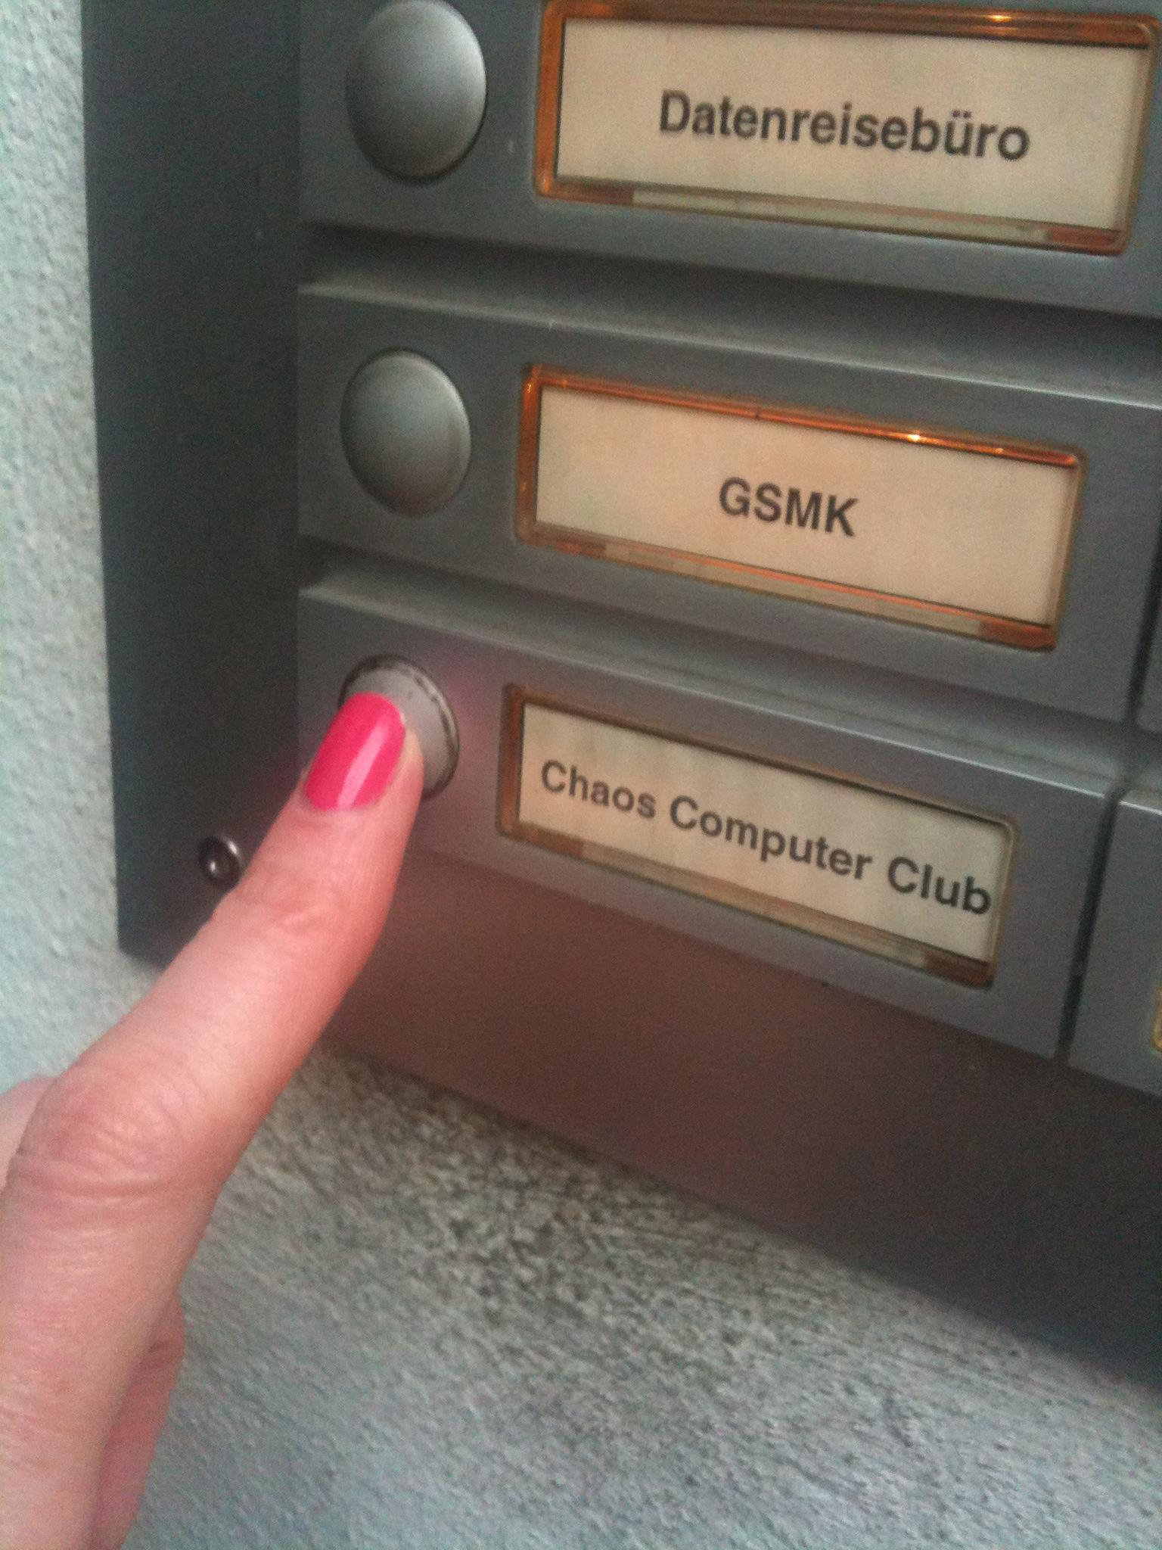
Obligatory
CCC
History

Slide 15
.: One of the first hackerspaces
.: Based in Germany
.: Formed around 1981

Slide 16
Other subsets / similar groups
.: Electronics Clubs

Slide 17
Other subsets / similar groups
.: Electronics Clubs
.: Maker spaces

Slide 18
Other subsets / similar groups
.: Electronics Clubs
.: Maker spaces
.: Think Tanks

Slide 19
Other subsets / similar groups
.: Electronics Clubs
.: Maker spaces
.: Think Tanks
.: Defcon Chapters

Slide 20
Other subsets / similar groups
.: Electronics Clubs
.: Maker spaces
.: Think Tanks
.: Defcon Chapters
.: Make: Groups

Slide 21
Other subsets / similar groups
.: Electronics Clubs
.: Maker spaces
.: Think Tanks
.: Defcon Chapters
.: Make: Groups
.: Ham Radio Groups

Slide 22
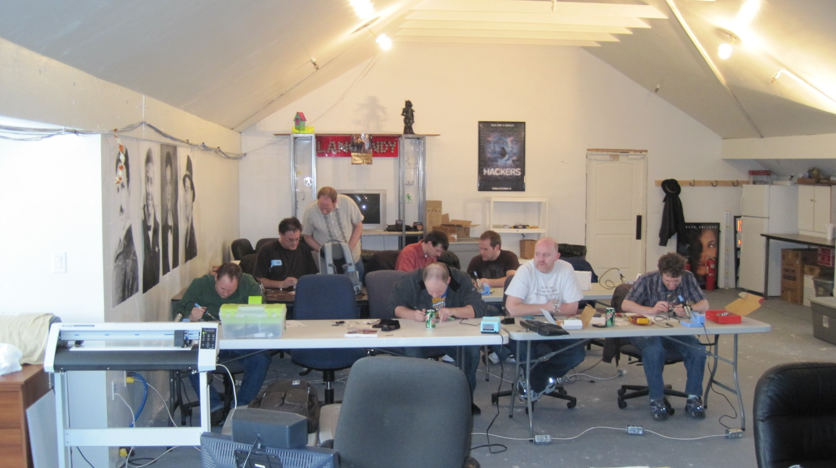

Slide 23
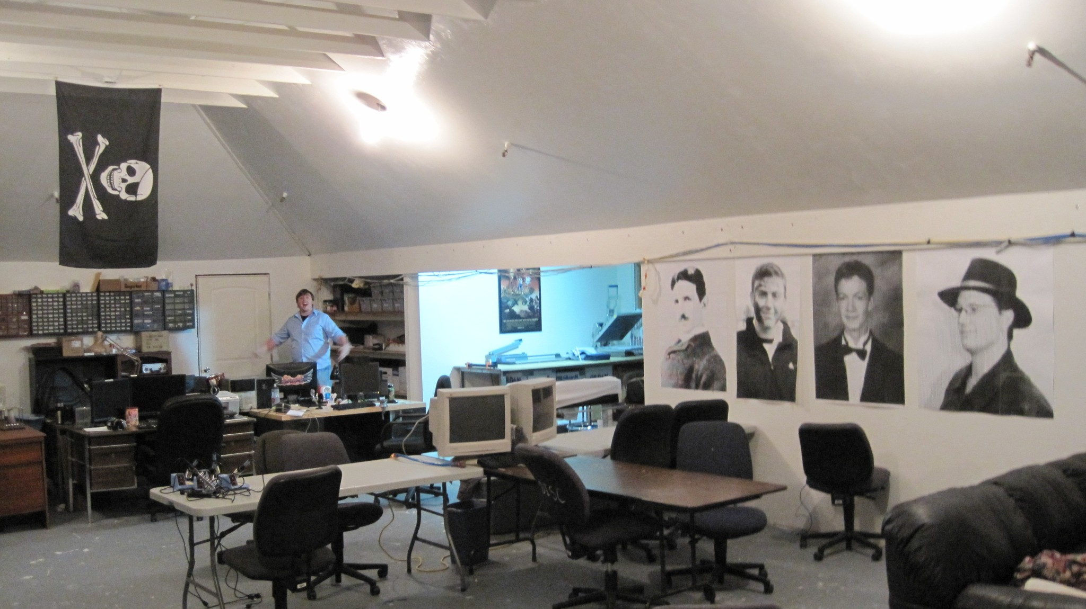

Slide 24
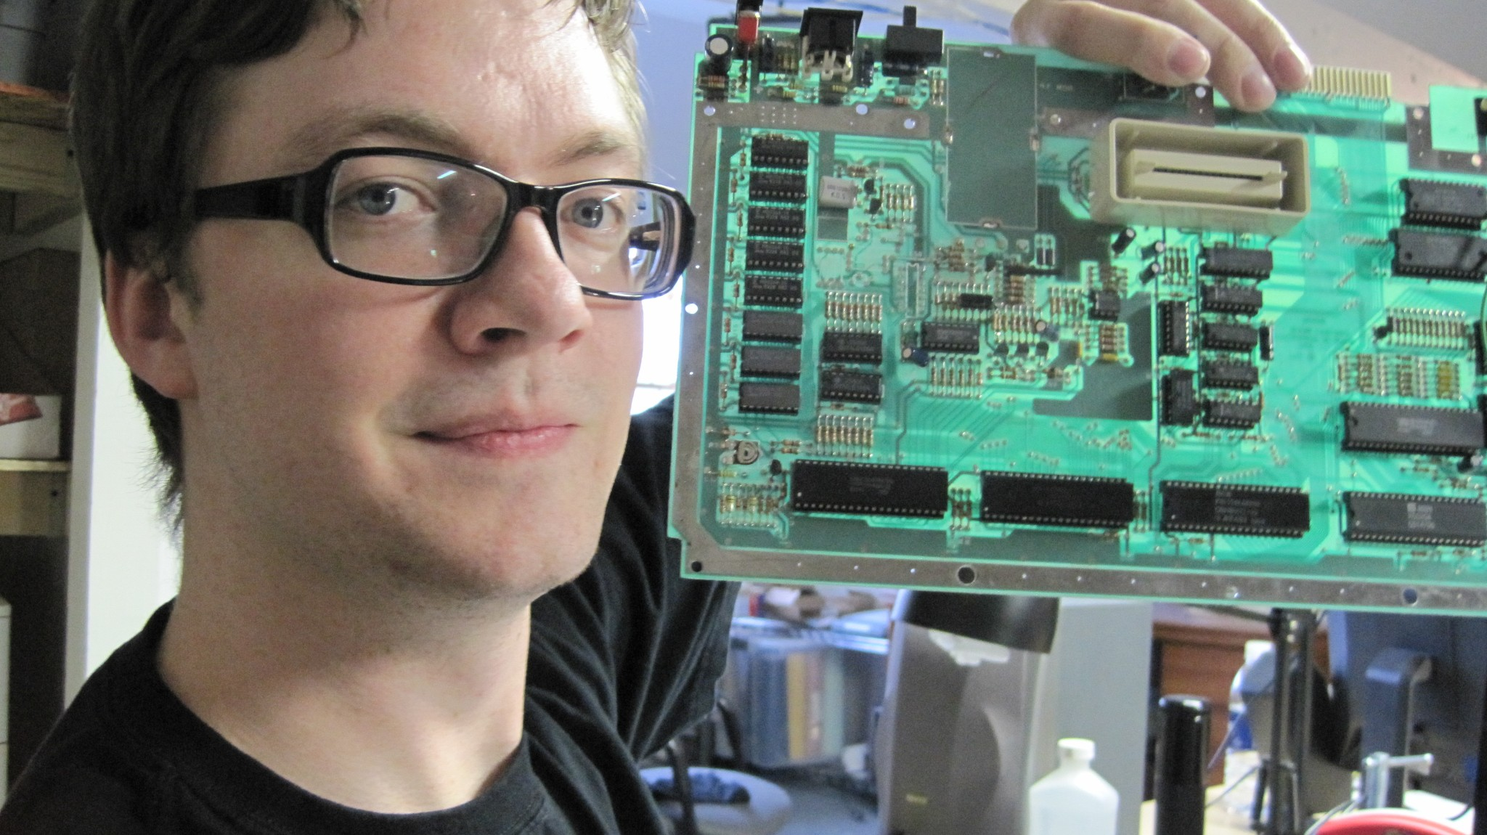

Slide 25
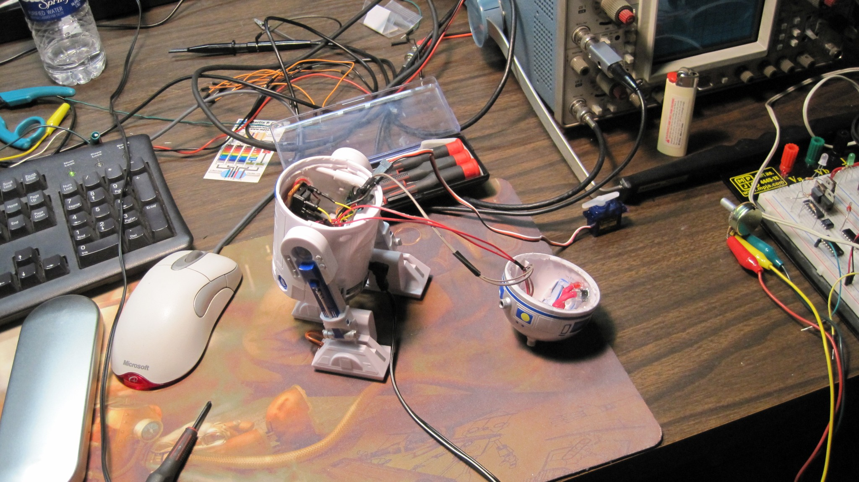

Slide 26
Is this common?

Slide 27
Is this common?
How many in: Utah ?

Slide 28
Is this common?
How many in: Utah (5-6)
.: TheTransistor / Darlington (Provo / Midvale)
.: Logan Laser Labs (Logan)
.: Mod Technologies (Ogden?)
.: MakeSLC (SLC)
.: ??? (Park City)
(*According to Hackerspaces.org)

Slide 29
Is this common?
How many in: USA?

Slide 30
Is this common?
How many in: USA?
About 200+
(*According to Hackerspaces.org, and my crappy guesswork)

Slide 31
Is this common?
How many in: World?

Slide 32
Is this common?
How many in: World?
Over 500
(*According to Hackerspaces.org, and my crappy guesswork)
/note Not over 9000

Slide 33
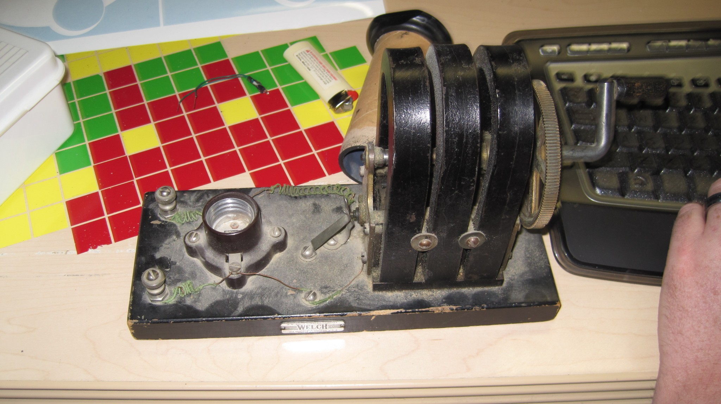

Slide 34
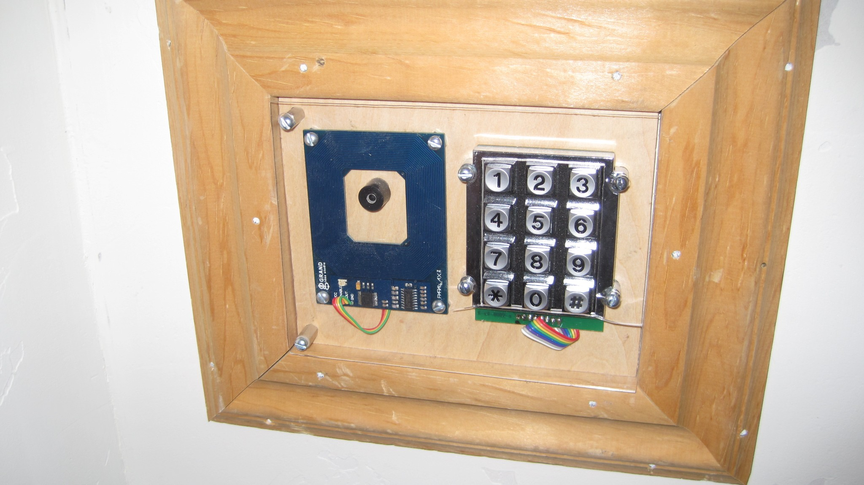

Slide 35
Why would you want to start a hackerspace?

Slide 36
Why would you want to start a hackerspace?
Ultimately depends on what you want

Slide 37
Why would you want to start a hackerspace?
Ultimately depends on what you want
.: Community
<< People that share some common ground with you.

Slide 38


Slide 39
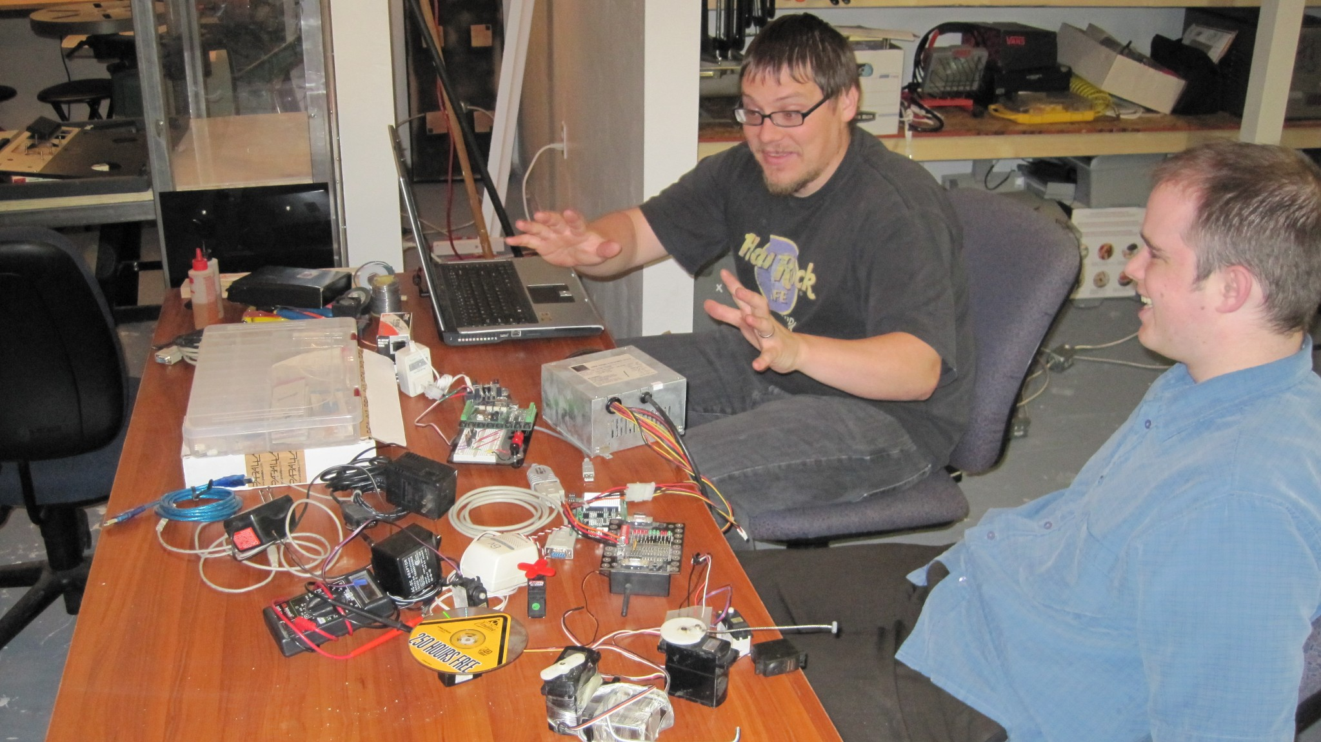

Slide 40
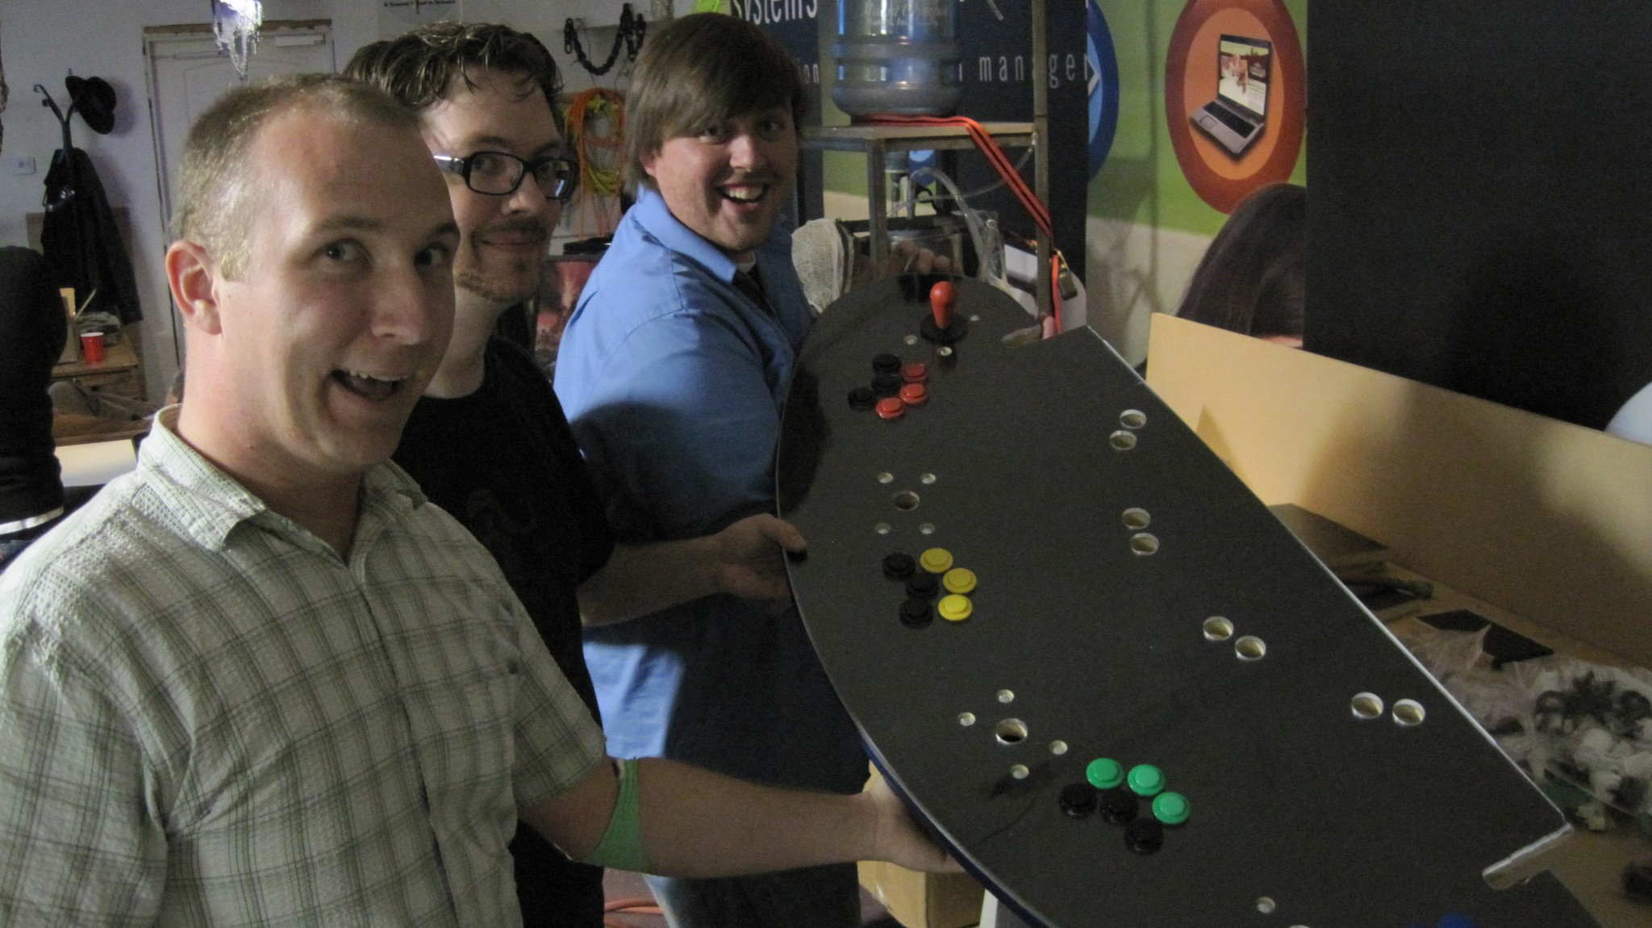

Slide 41
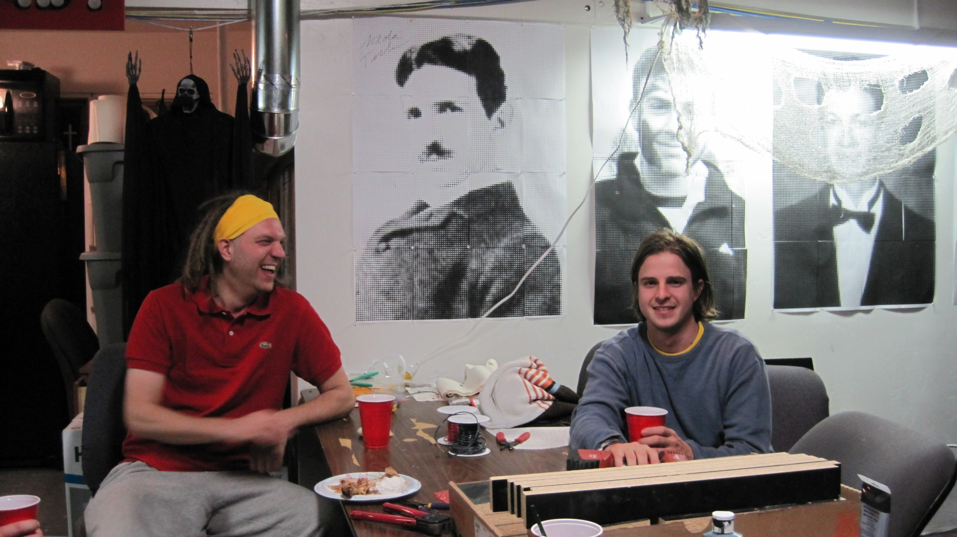

Slide 42
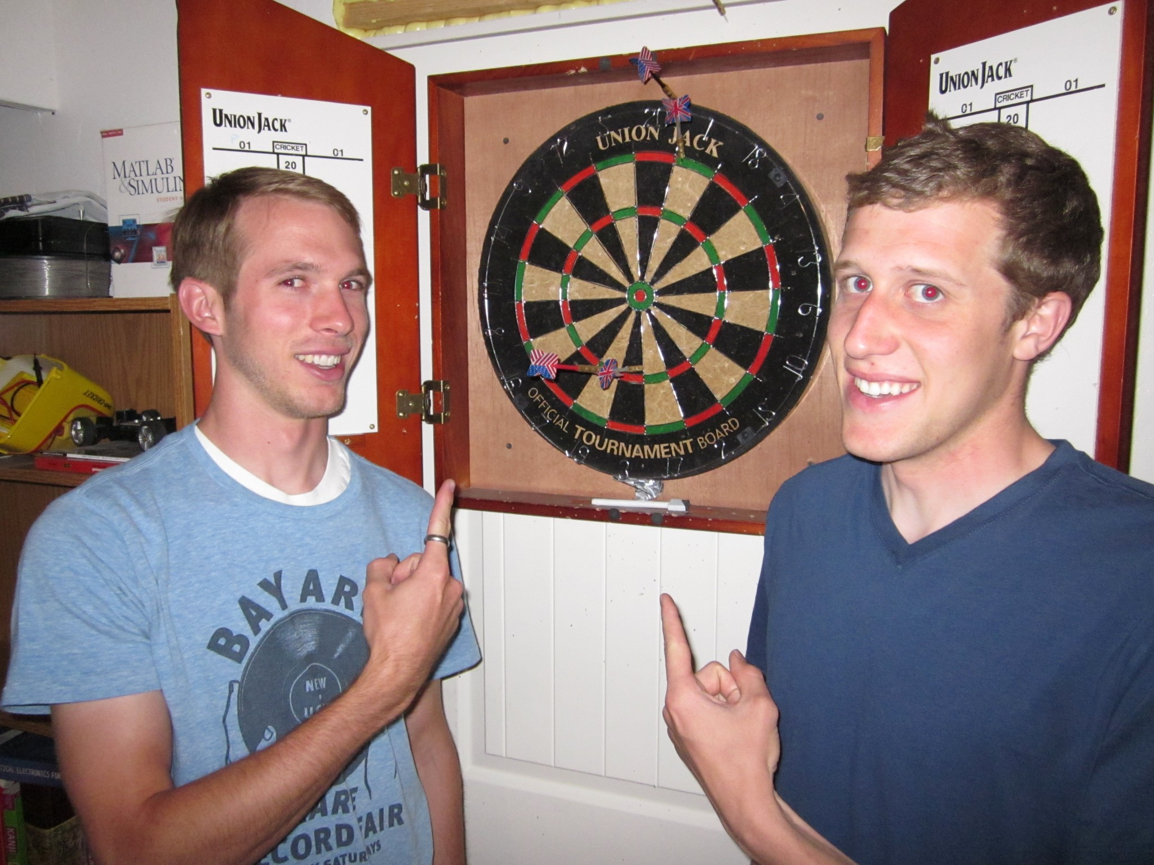

Slide 43
Why would you want to start a hackerspace?
Ultimately depends on what you want
.: Community
<< People that share some common ground with you.
.: Access to better tools / equipment / etc.
<< Donated tools. Pool resources to get nicer stuff.

Slide 44
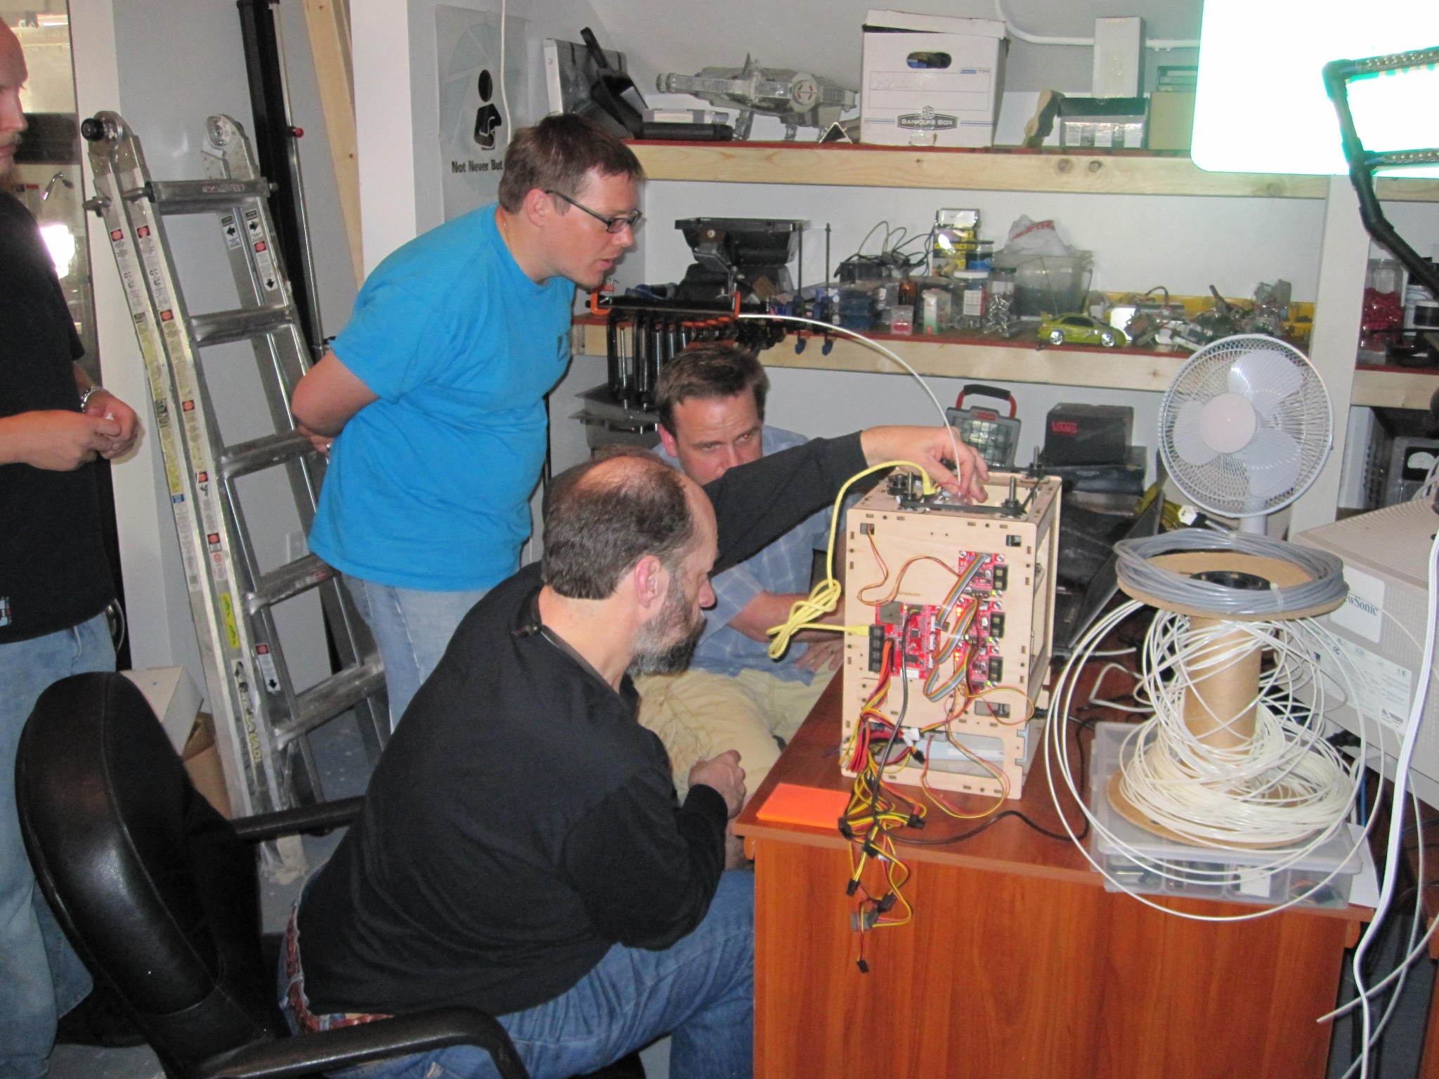

Slide 45
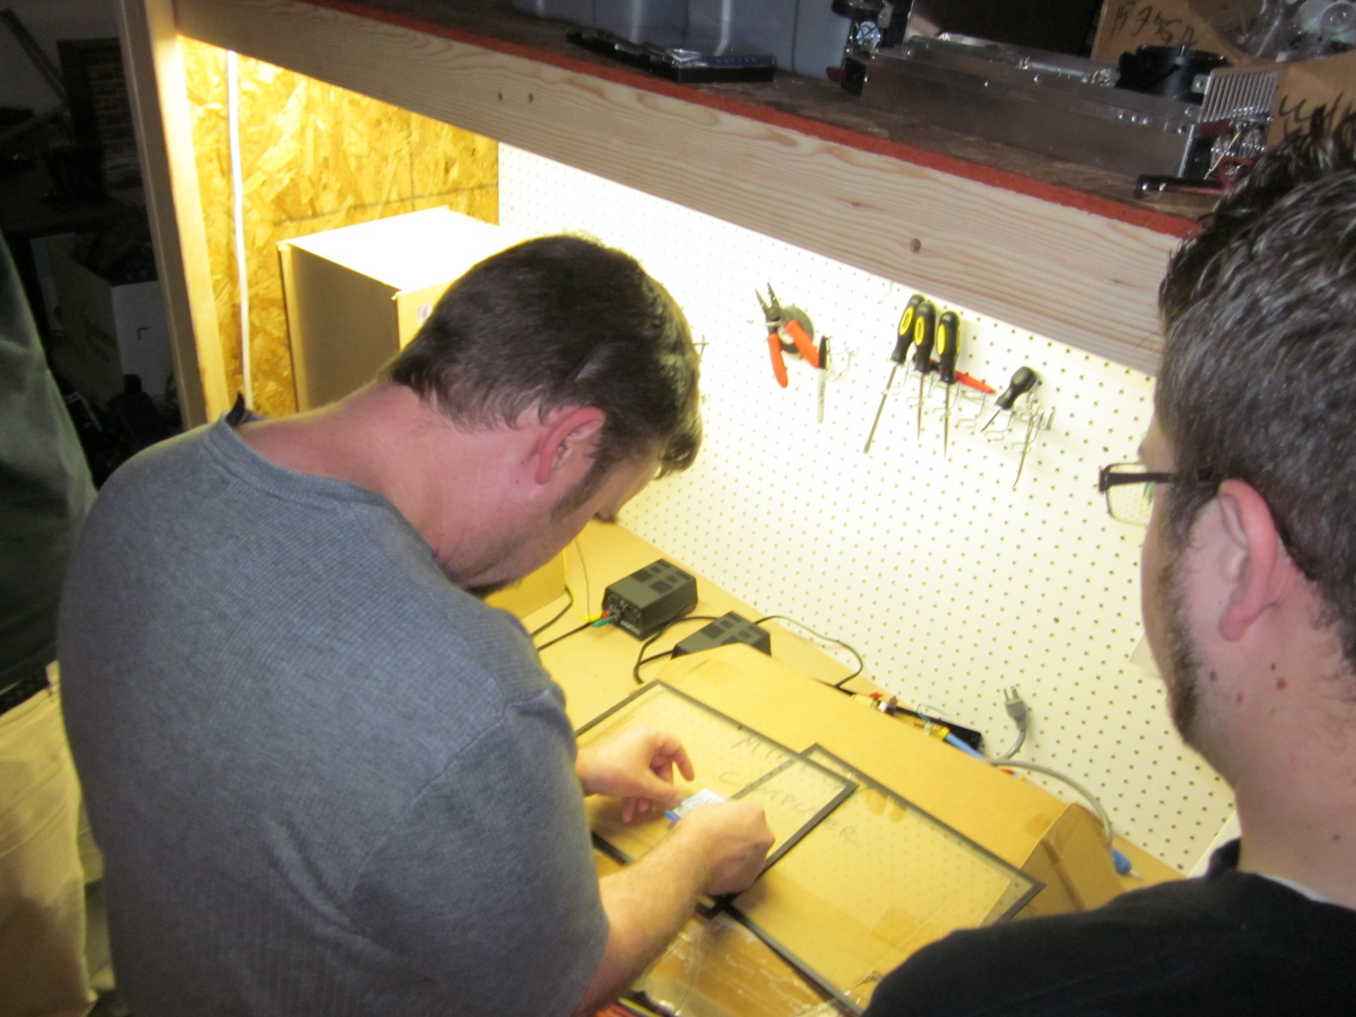

Slide 46
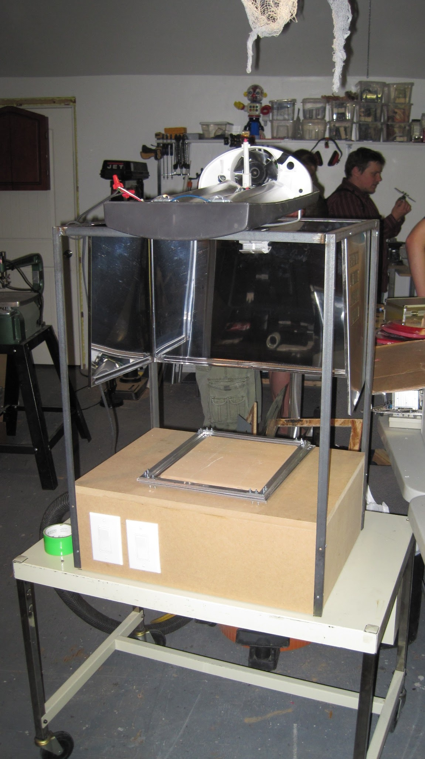

Slide 47
Why would you want to start a hackerspace?
Ultimately depends on what you want
.: Community
<< People that share some common ground with you.
.: Access to better tools / equipment / etc.
<< Donated tools. Pool resources to get nicer stuff.
.: Sharing knowledge
<< Asking AND answering questions.

Slide 48
Why would you want to start a hackerspace?
Ultimately depends on what you want
.: Community
<< People that share some common ground with you.
.: Access to better tools / equipment / etc.
<< Donated tools. Pool resources to get nicer stuff.
.: Sharing knowledge
<< Asking AND answering questions.
.: Fun
<< Shenanigans, Pranks, General Silliness

Slide 49
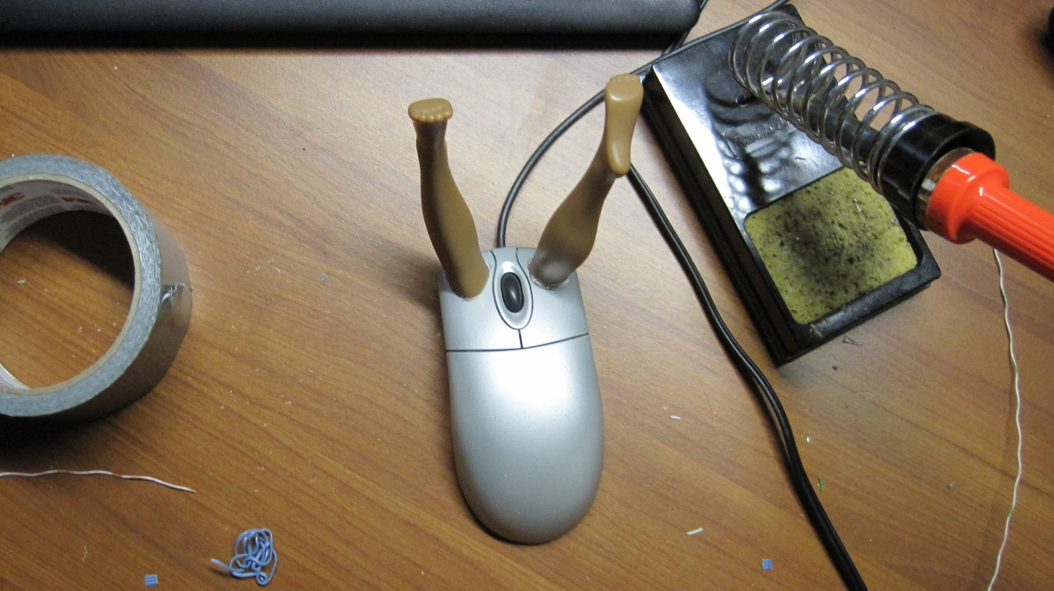

Slide 50
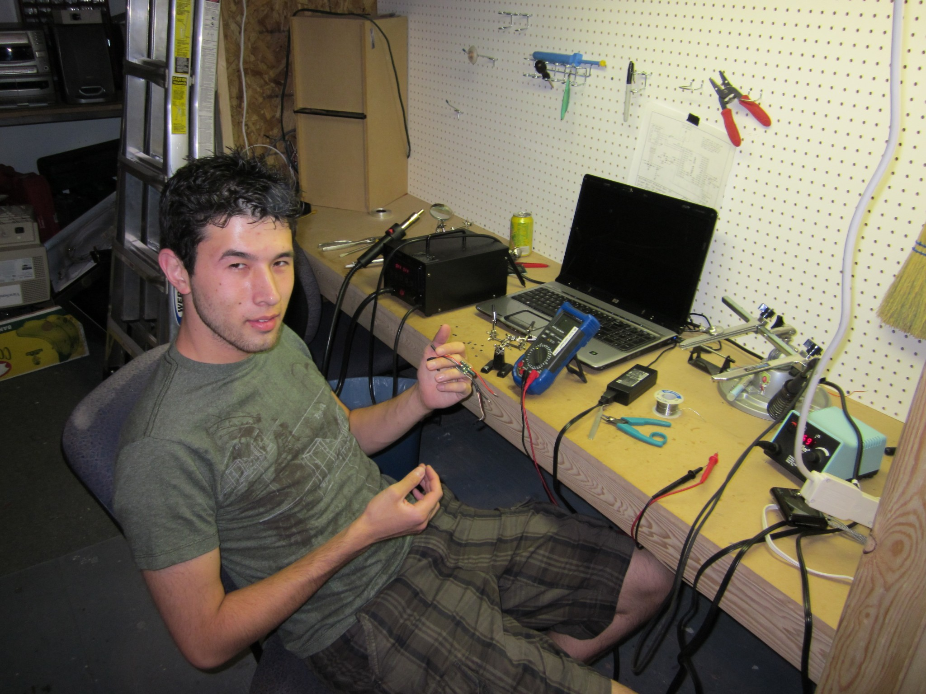

Slide 51
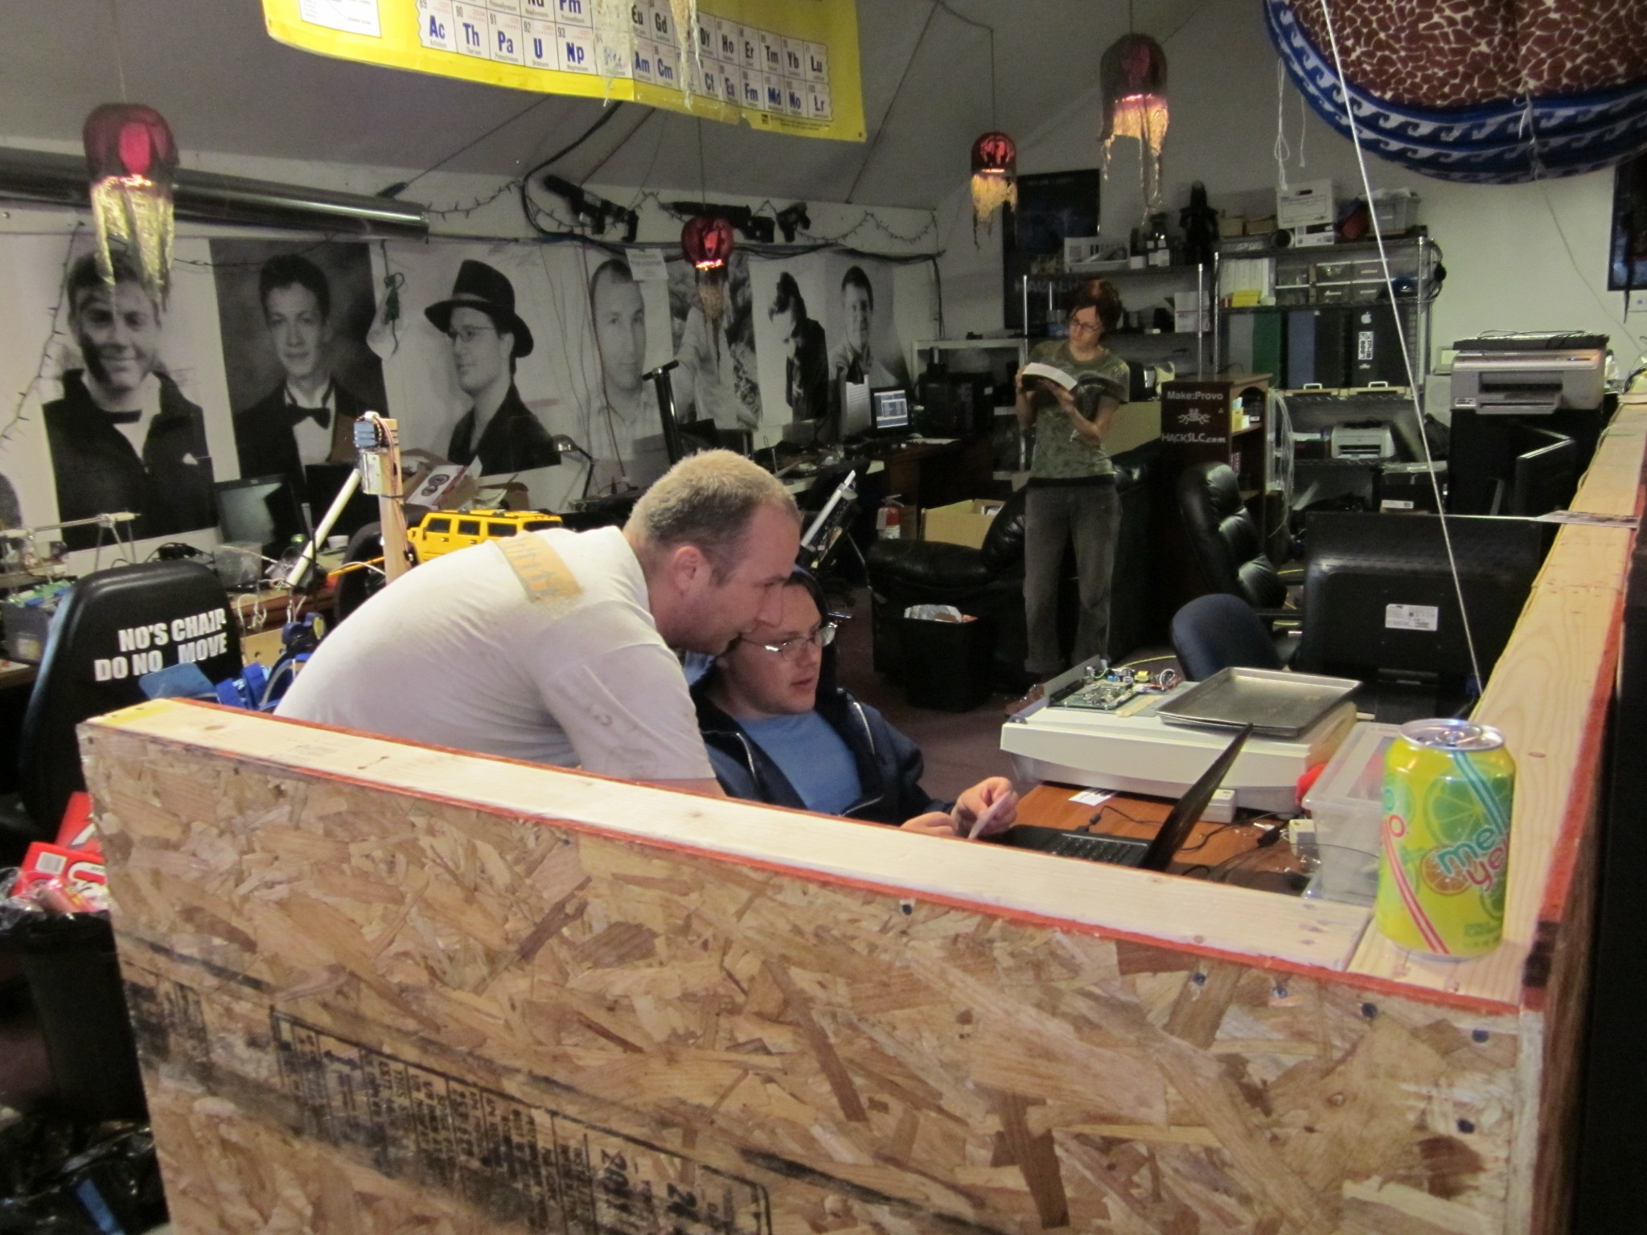

Slide 52
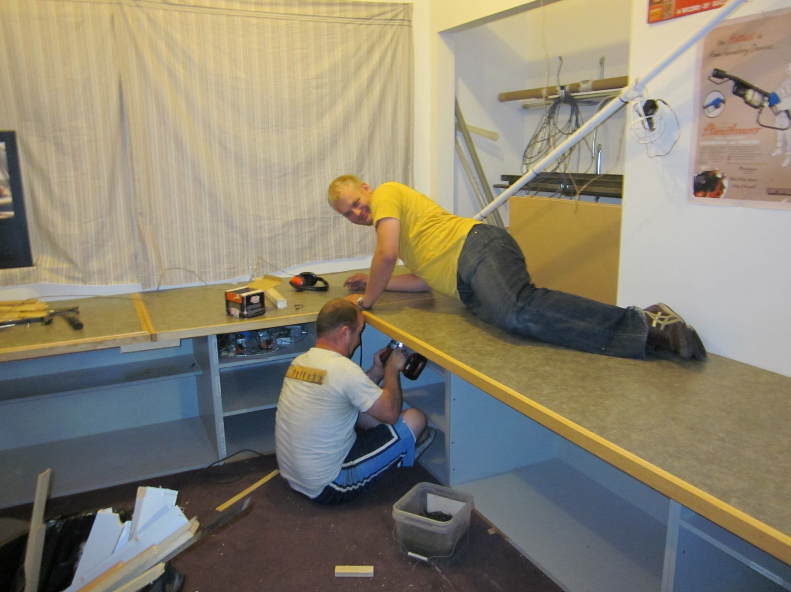

Slide 53
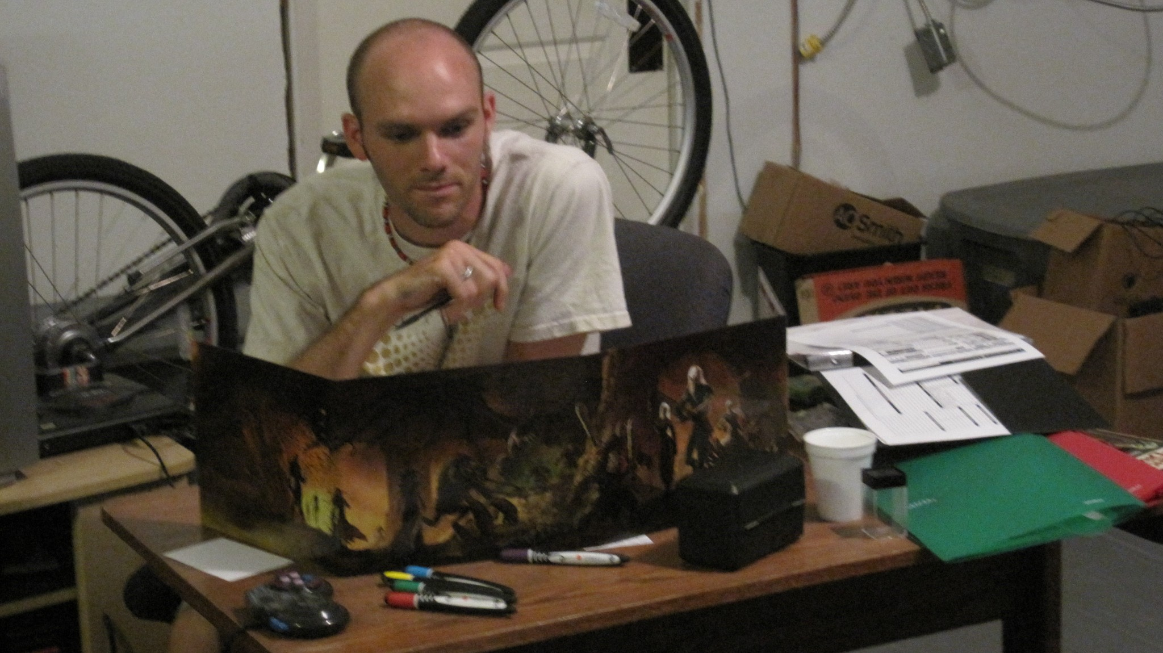

Slide 54
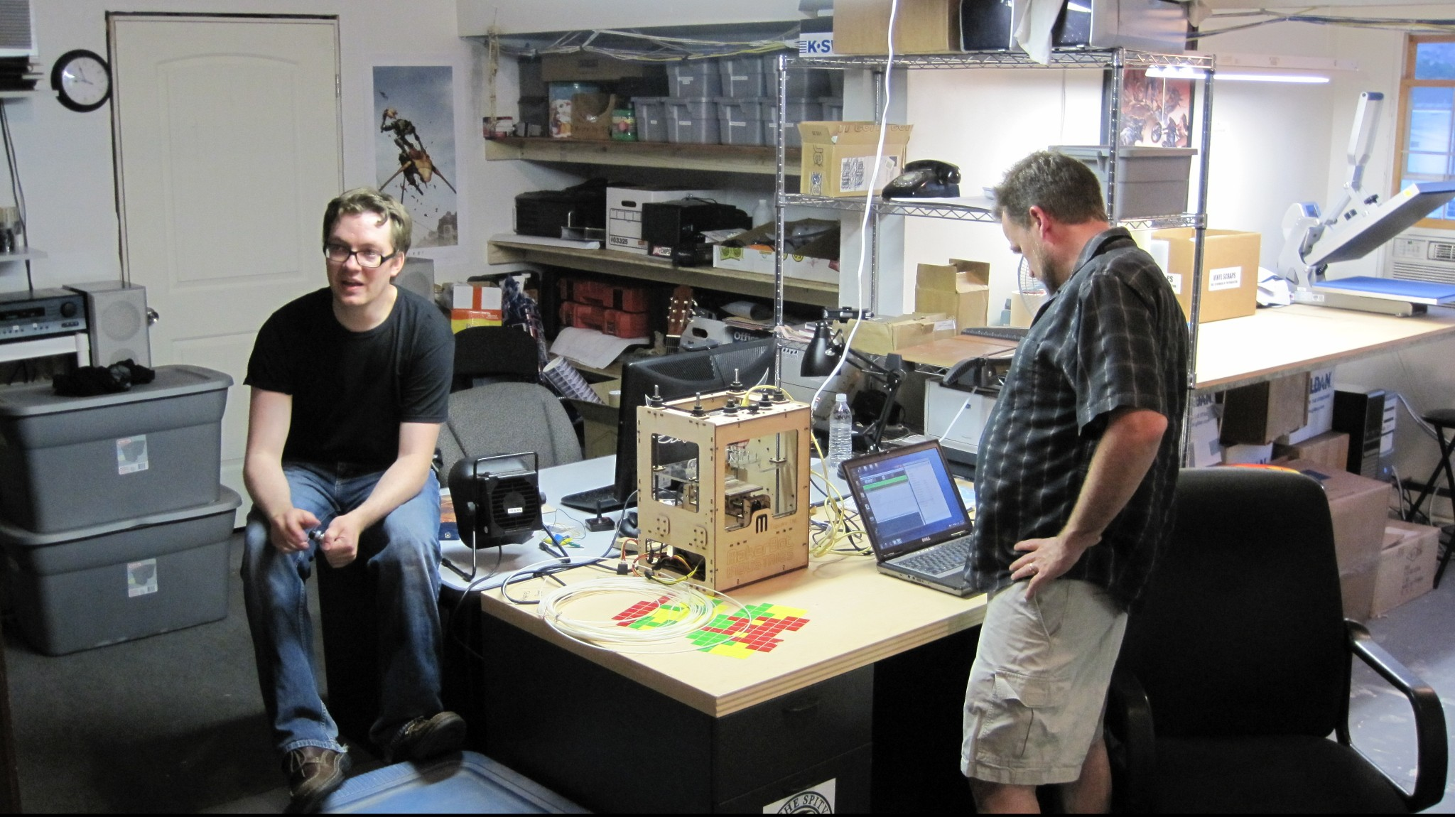

Slide 55
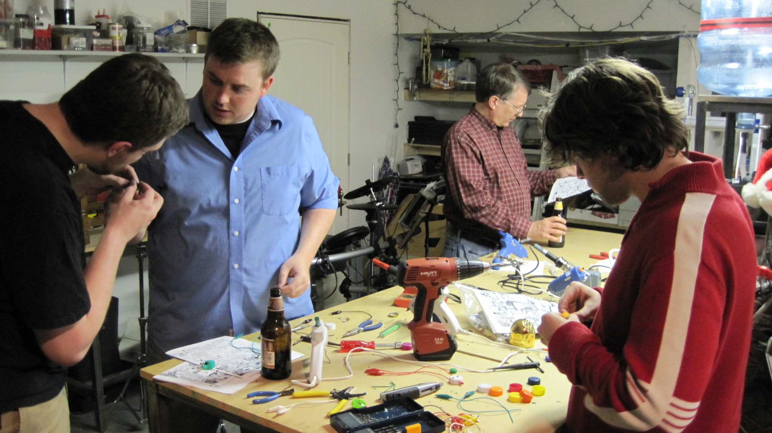

Slide 56
Why would you want to start a hackerspace?
Ultimately depends on what you want
.: Community
<< People that share some common ground with you.
.: Access to better tools / equipment / etc.
<< Donated tools. Pool resources to get nicer stuff.
.: Sharing knowledge
<< Asking AND answering questions.
.: Fun
<< Shenanigans, Pranks, General Silliness
.: A place for projects you don't want at home
<< Large projects, dangerous projects, obscene projects...

Slide 57
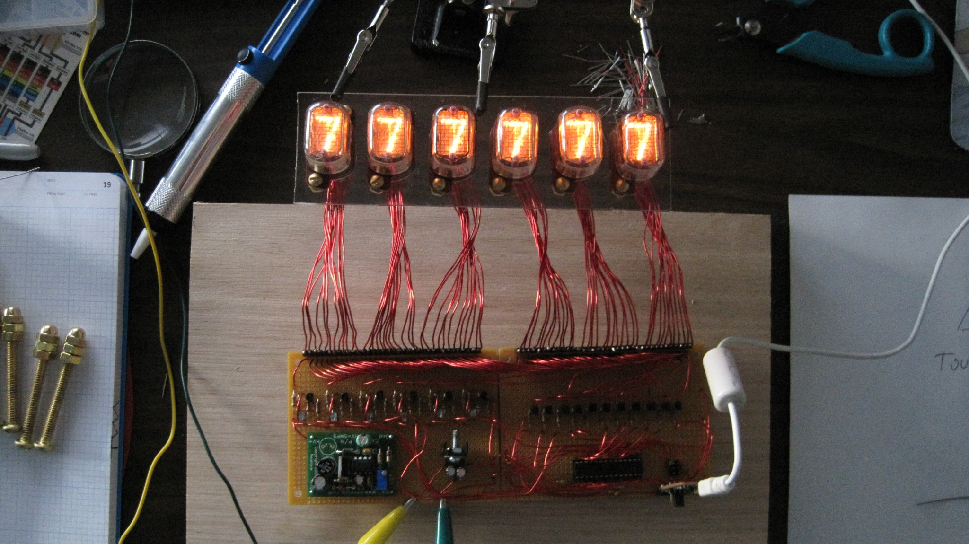

Slide 58
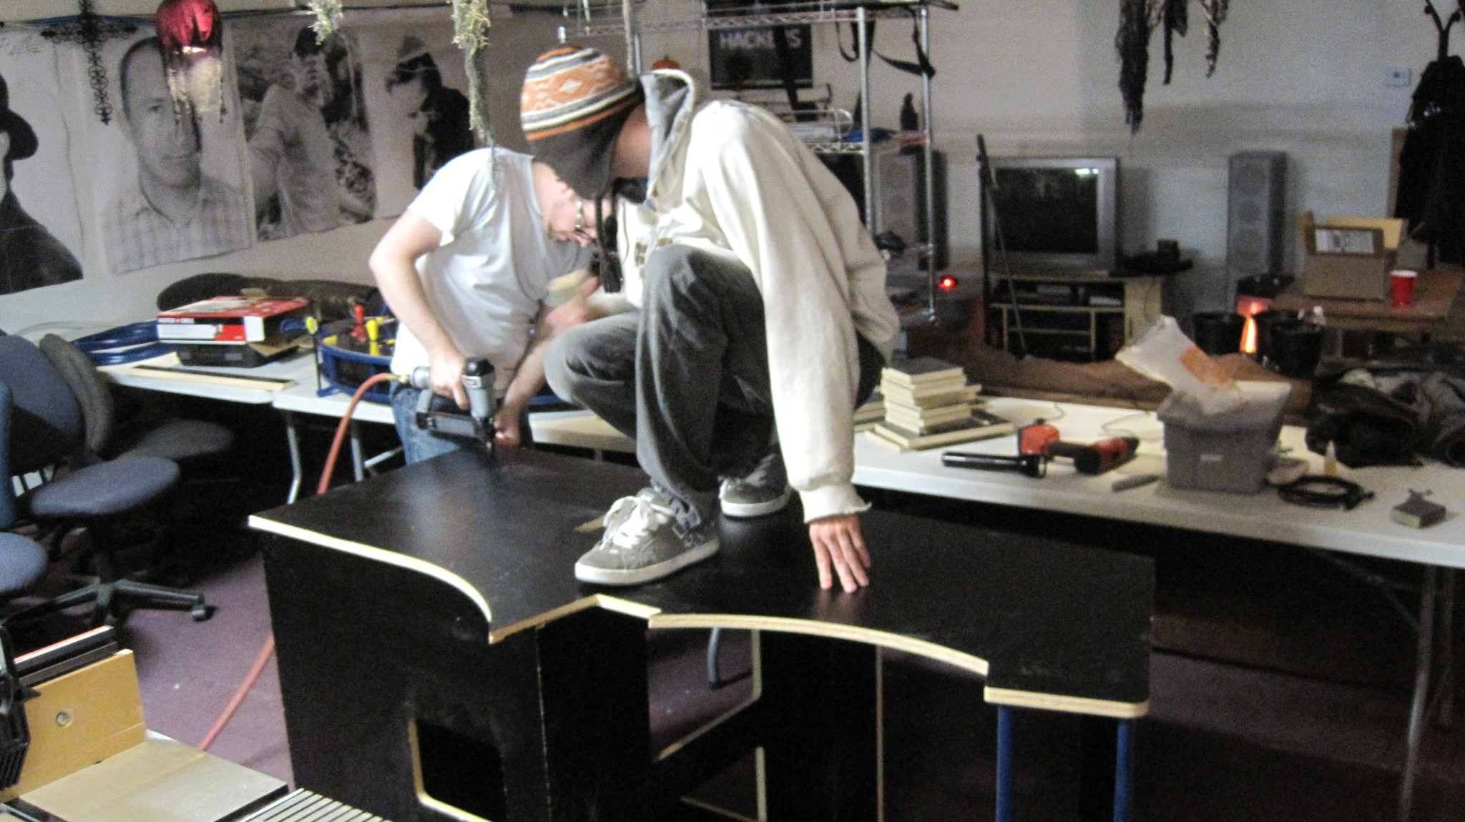

Slide 59
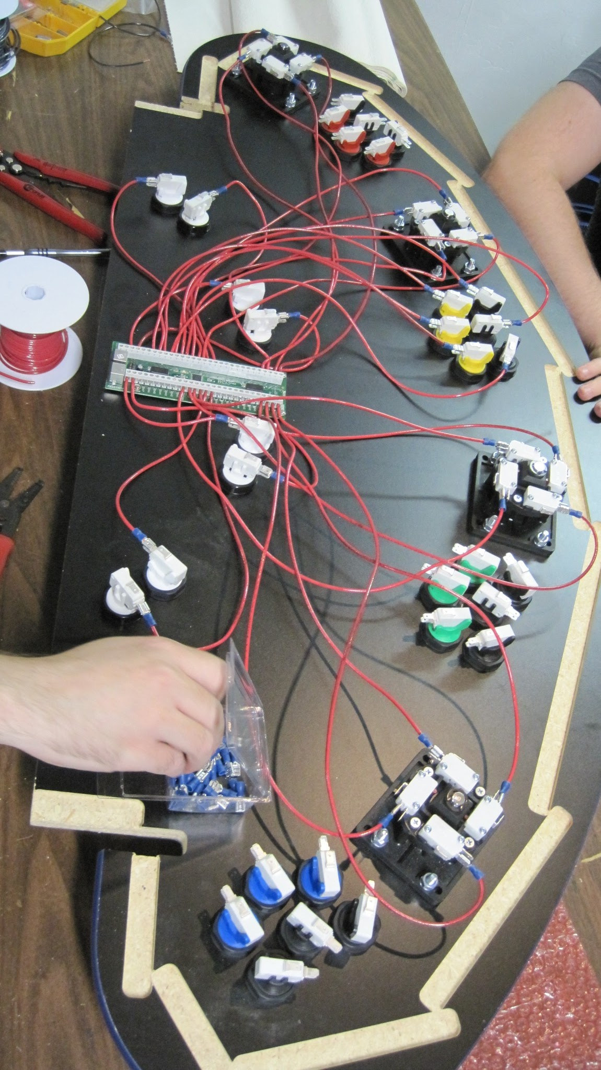

Slide 60
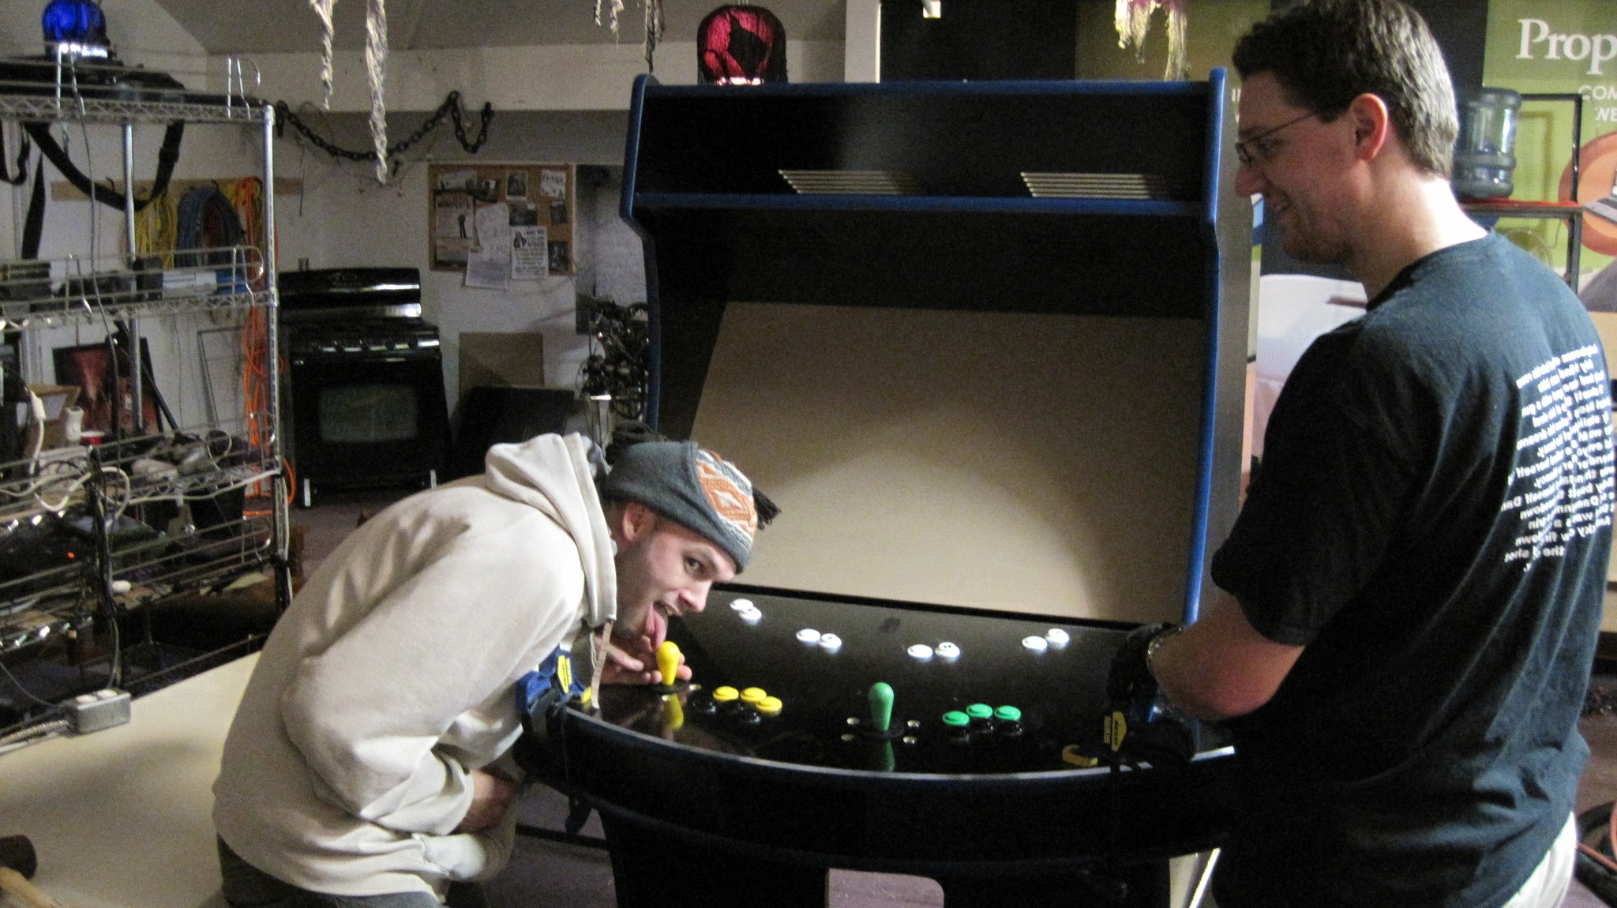

Slide 61
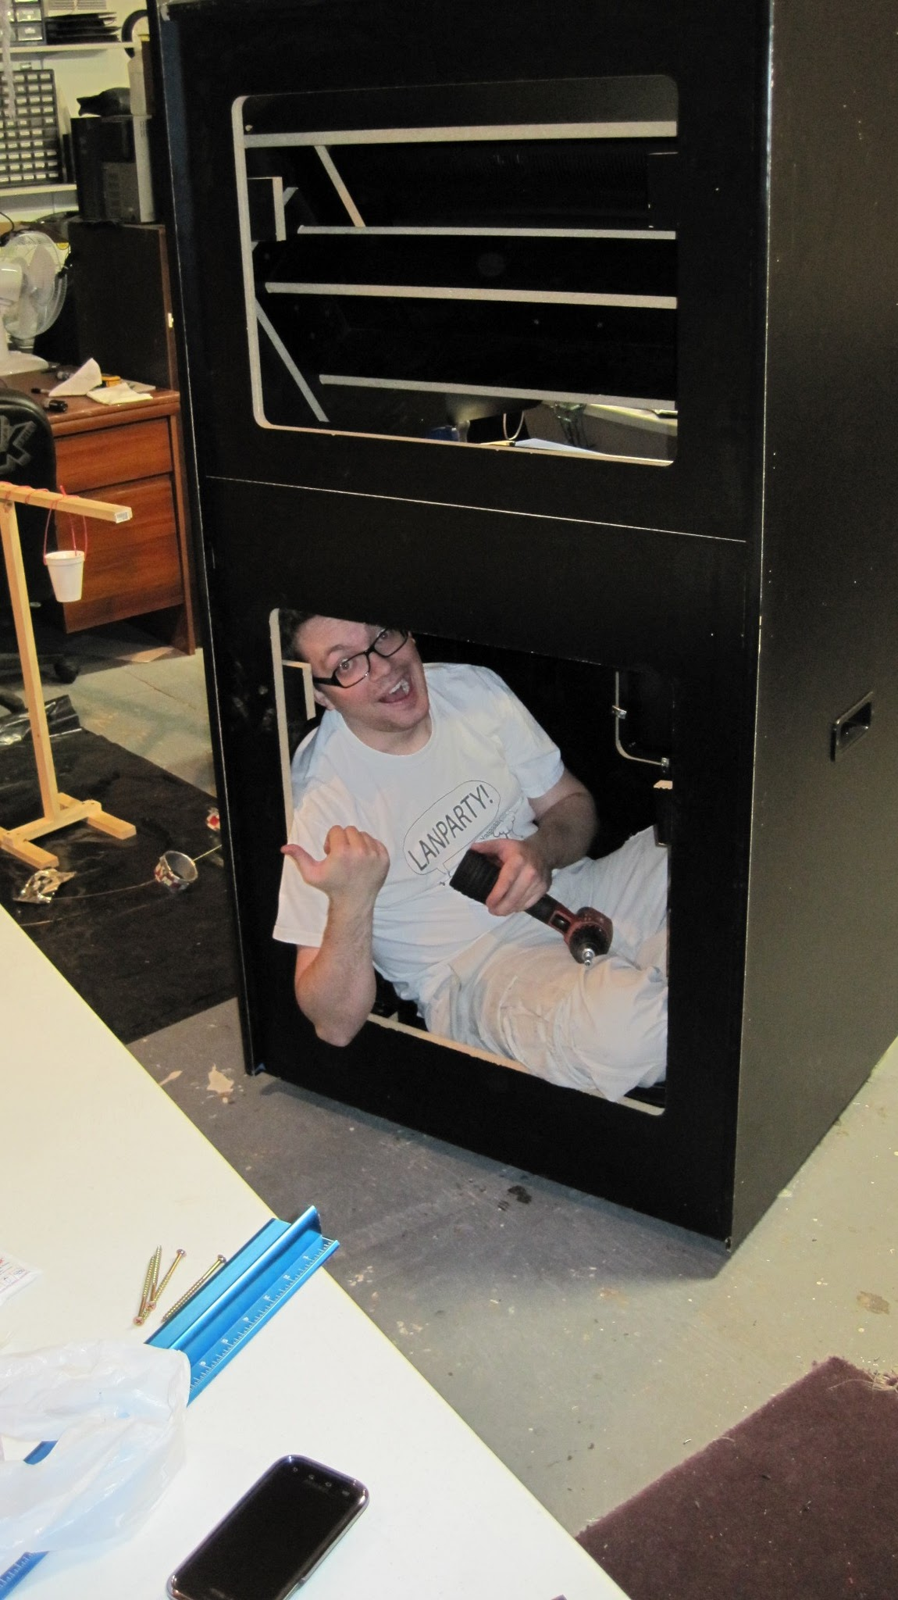

Slide 62
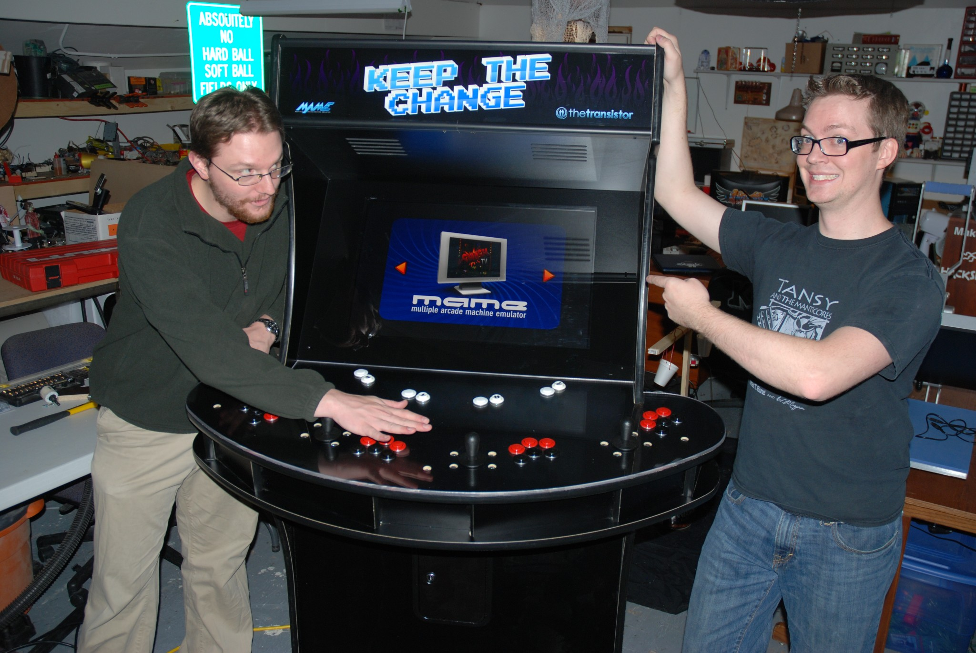

Slide 63
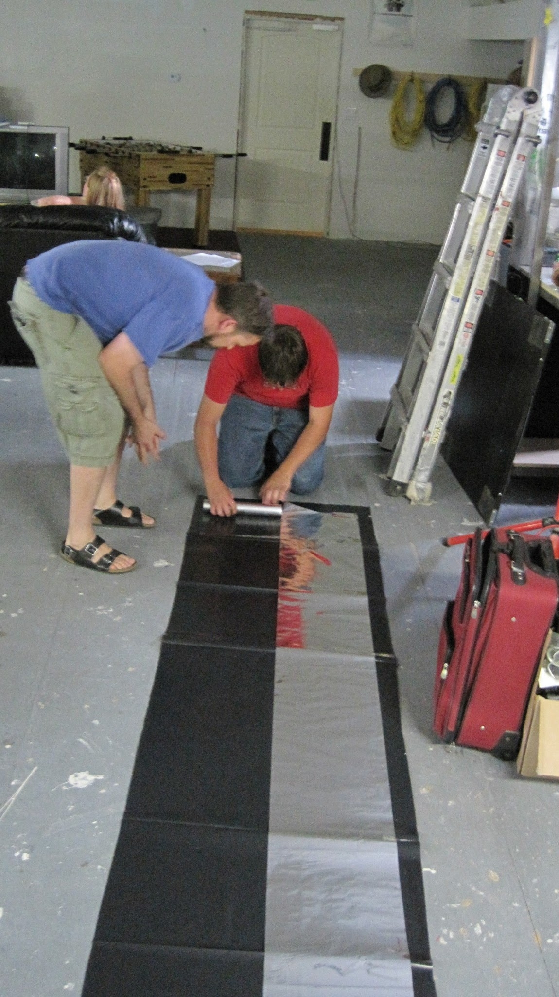

Slide 64
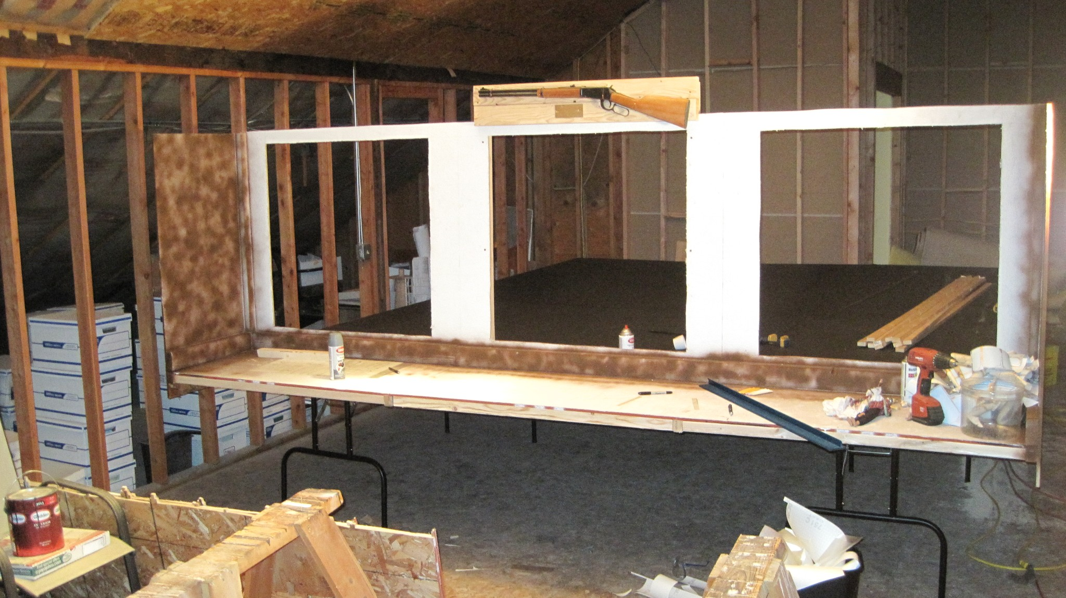

Slide 65
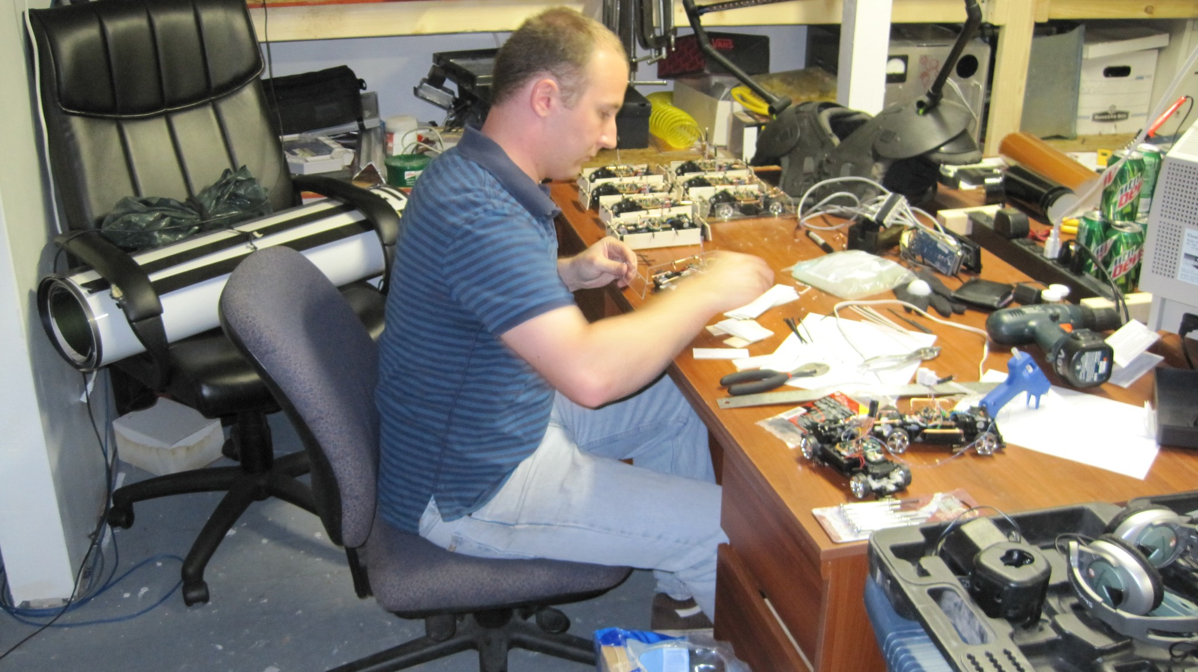

Slide 66
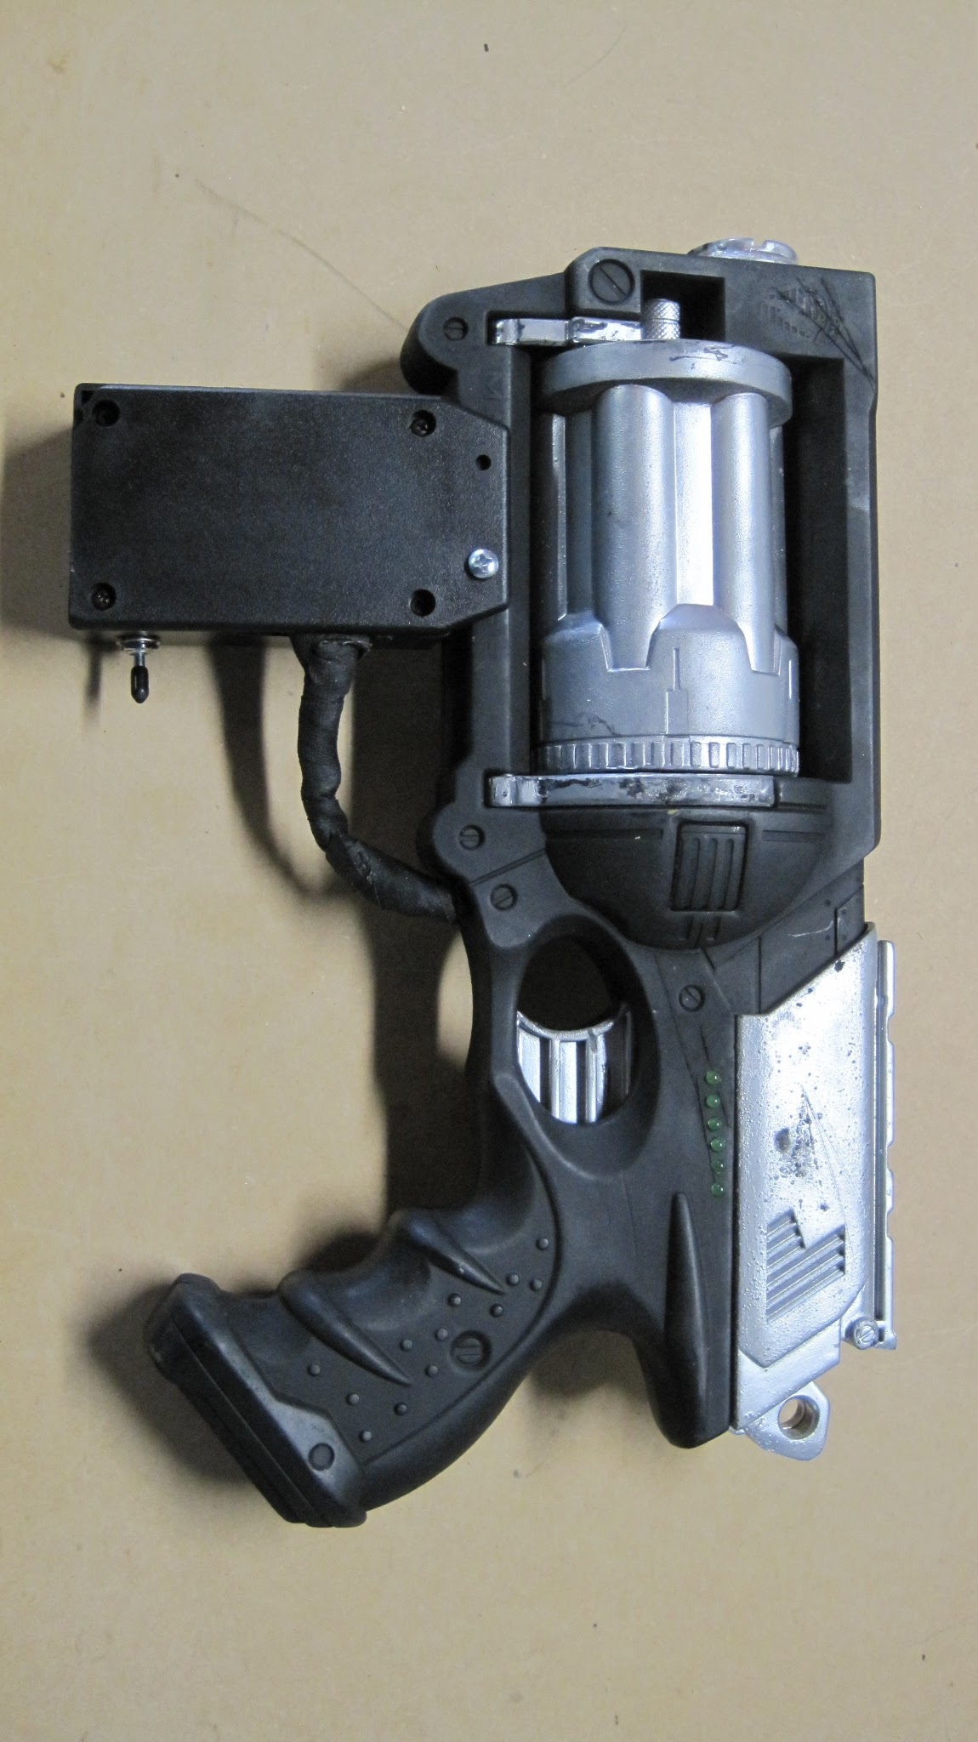

Slide 67
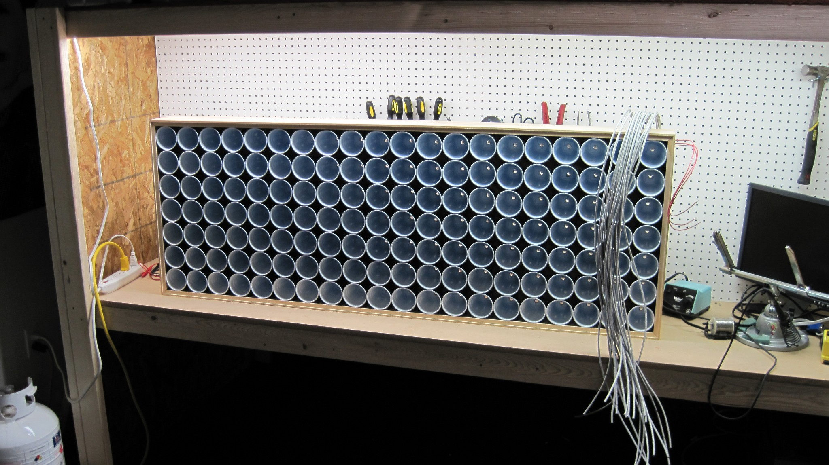

Slide 68
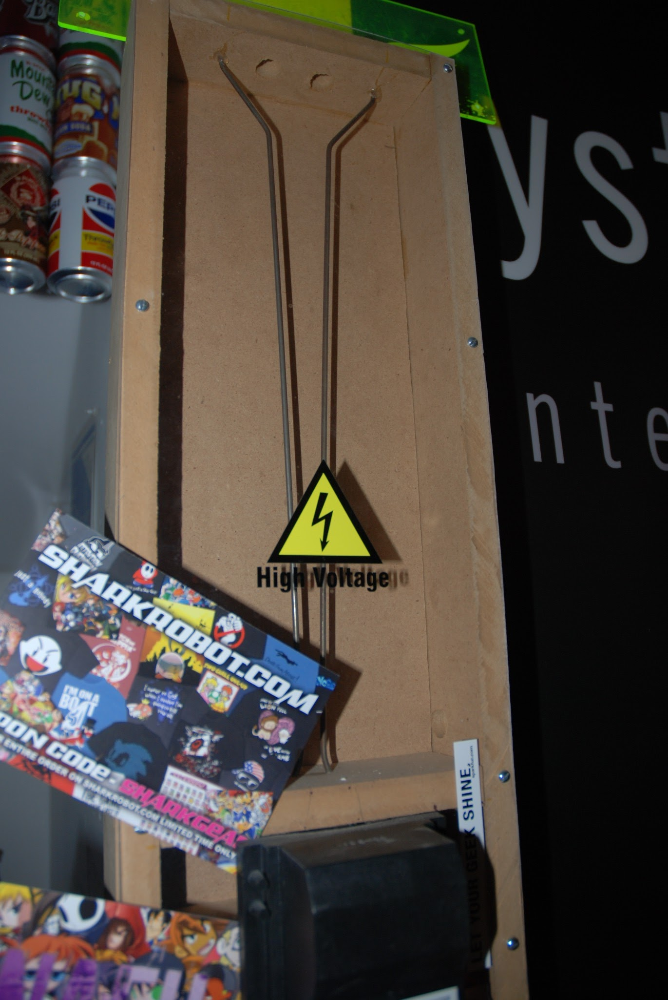

Slide 69
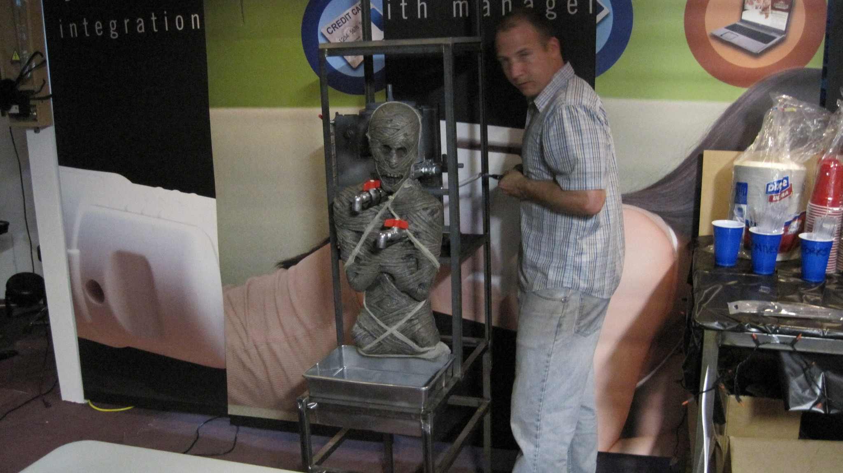

Slide 70
The Hacker Ethic:

Slide 71
The Hacker Ethic:
As Levy summarized in the preface of Hackers, the general tenets or principles of hacker ethic include:
.: Sharing

Slide 72
The Hacker Ethic:
As Levy summarized in the preface of Hackers, the general tenets or principles of hacker ethic include:
.: Sharing
.: Openness

Slide 73
The Hacker Ethic:
As Levy summarized in the preface of Hackers, the general tenets or principles of hacker ethic include:
.: Sharing
.: Openness
.: Decentralization

Slide 74
The Hacker Ethic:
As Levy summarized in the preface of Hackers, the general tenets or principles of hacker ethic include:
.: Sharing
.: Openness
.: Decentralization
.: Free access to computers

Slide 75
The Hacker Ethic:
As Levy summarized in the preface of Hackers, the general tenets or principles of hacker ethic include:
.: Sharing
.: Openness
.: Decentralization
.: Free access to computers
.: World Improvement

Slide 76
The Hacker Ethic:
At MIT the hacker ethic actually describes the qualities that a 'hack' (a covert modification to the MIT campus) must have. It must:

Slide 77
The Hacker Ethic:
At MIT the hacker ethic actually describes the qualities that a 'hack' (a covert modification to the MIT campus) must have. It must:
.: be safe

Slide 78
The Hacker Ethic:
At MIT the hacker ethic actually describes the qualities that a 'hack' (a covert modification to the MIT campus) must have. It must:
.: be safe
.: not damage anything

Slide 79
The Hacker Ethic:
At MIT the hacker ethic actually describes the qualities that a 'hack' (a covert modification to the MIT campus) must have. It must:
.: be safe
.: not damage anything
.: not damage anyone, either physically, mentally or emotionally

Slide 80
The Hacker Ethic:
At MIT the hacker ethic actually describes the qualities that a 'hack' (a covert modification to the MIT campus) must have. It must:
.: be safe
.: not damage anything
.: not damage anyone, either physically, mentally or emotionally
.: be funny, at least to most of the people who experience it

Slide 81
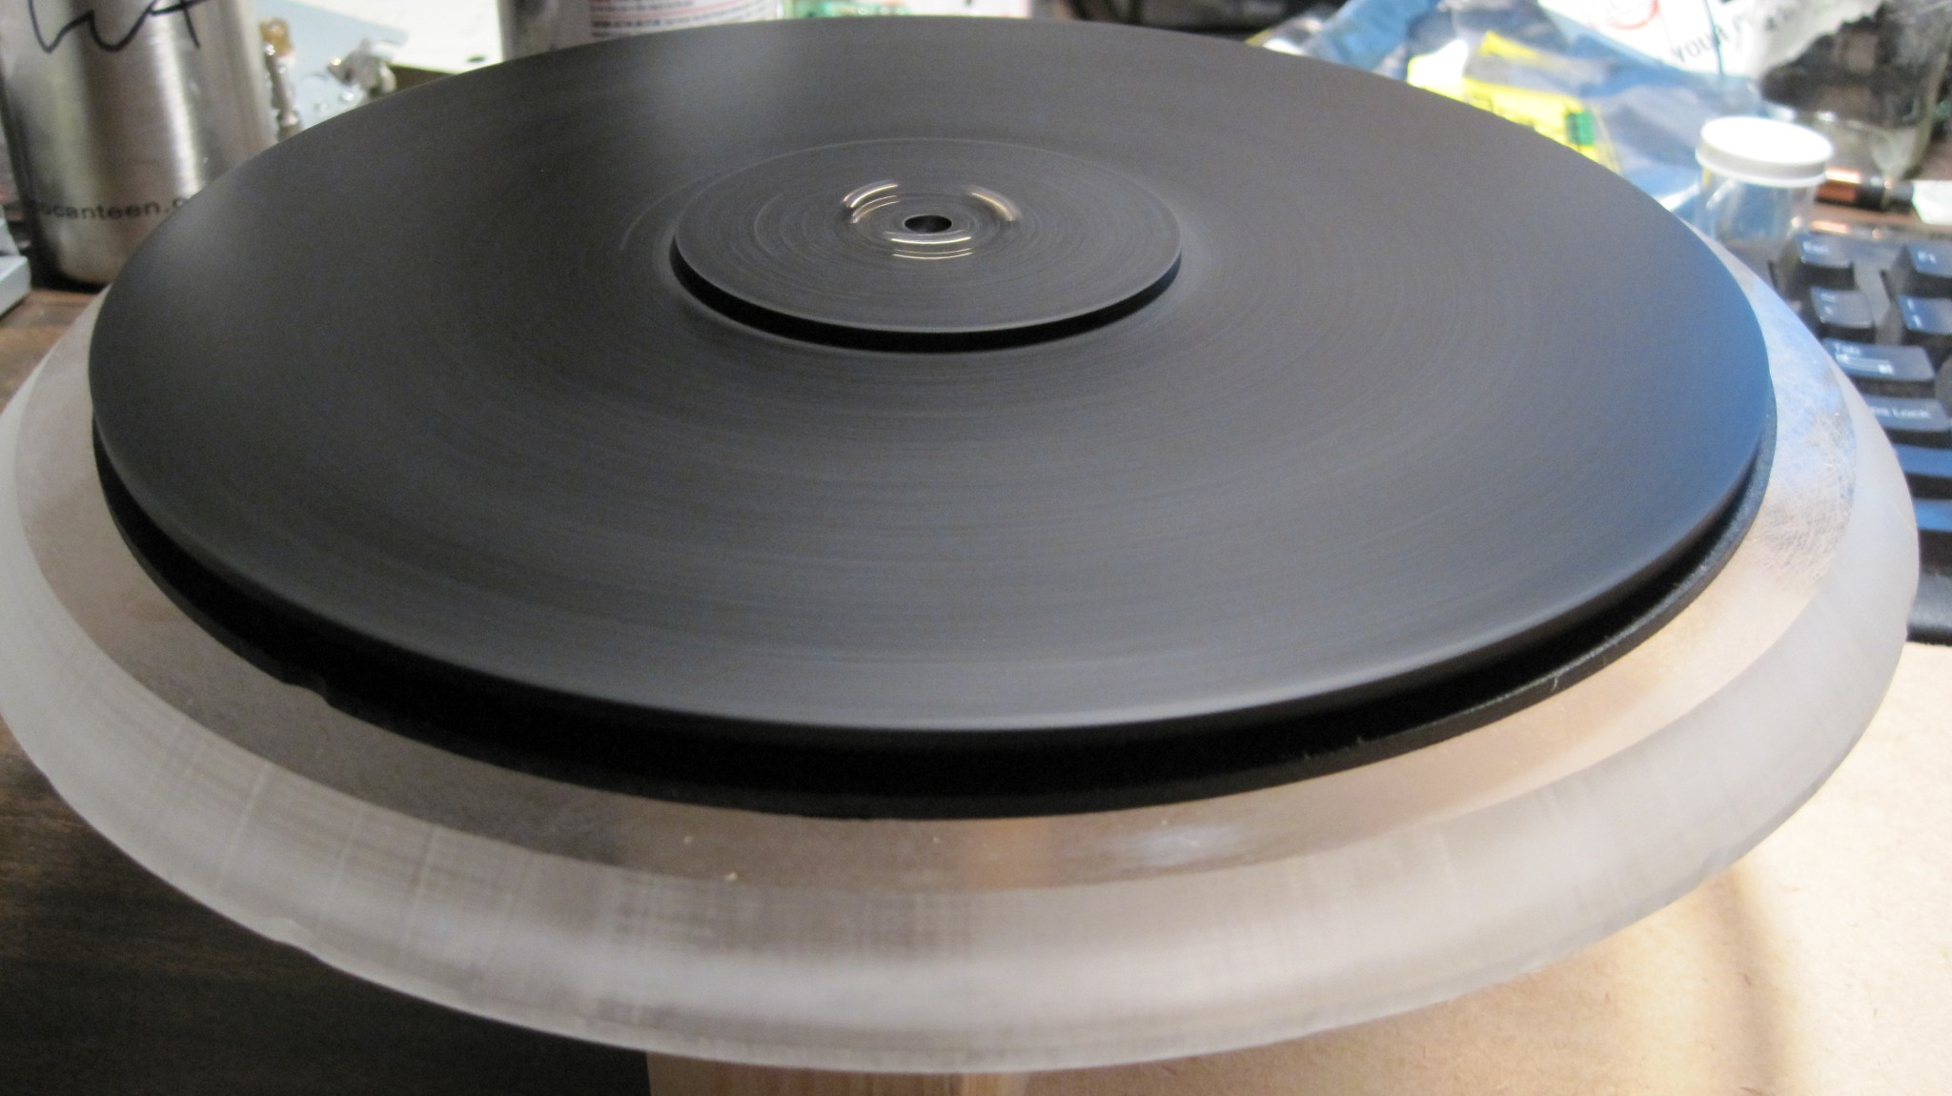

Slide 82
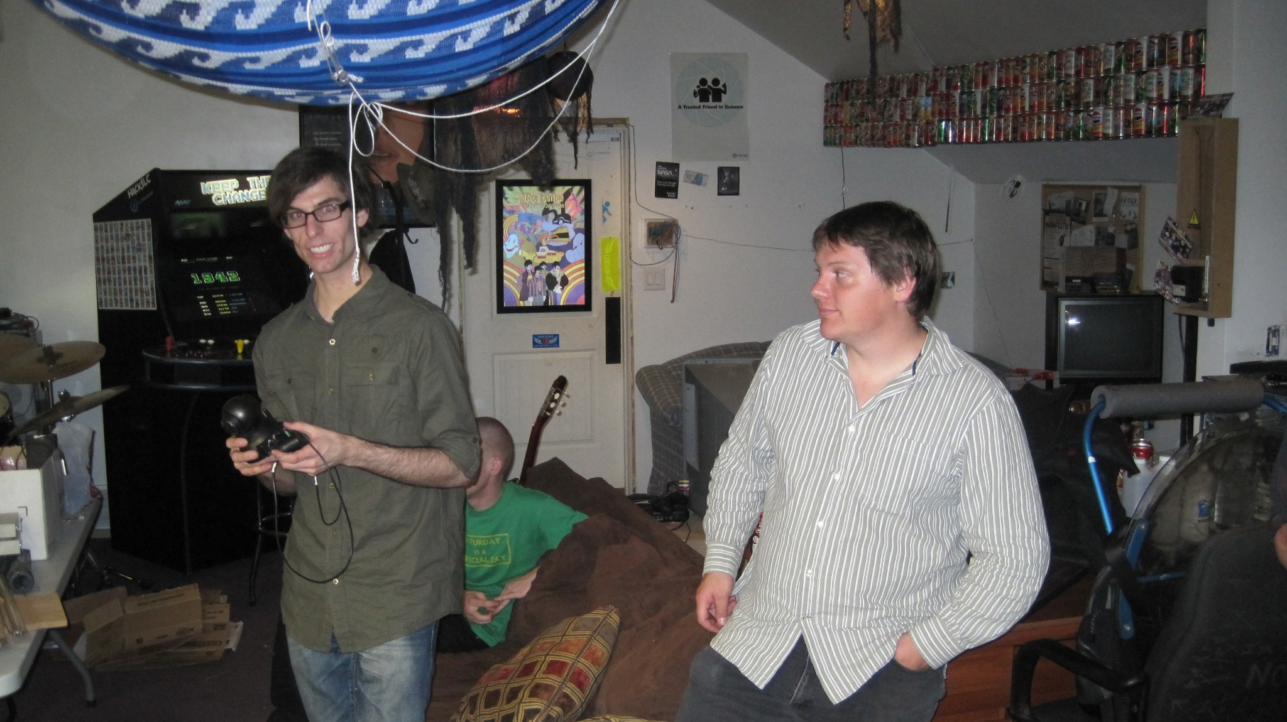

Slide 83
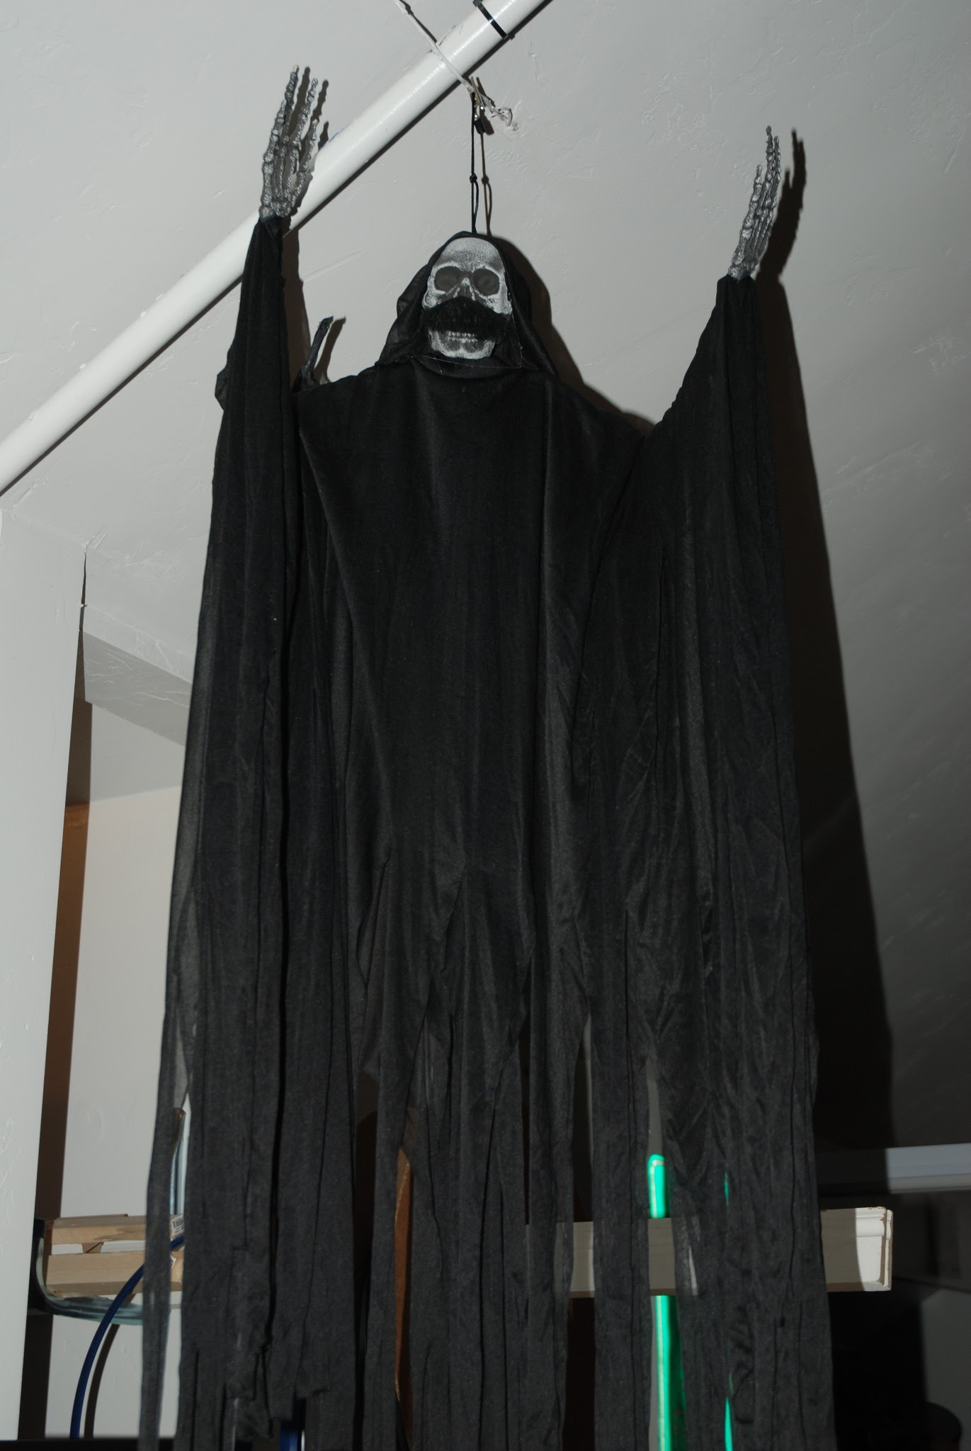

Slide 84
Sweet. I want to start one!

Slide 85
Sweet. I want to start one!
ARE YOU CRAZY?

Slide 86
Sweet. I want to start one!
ARE YOU CRAZY?
NO
YES
You don't have to be.
It helps

Slide 88
Sweet. I want to start one!
Step 0 - Is there an existing hackerspace nearby?
(If so, you should visit it and see if it meets your needs)

Slide 89
Sweet. I want to start one!
Step 0 - Is there an existing hackerspace nearby?
(If so, you should visit it and see if it meets your needs)
Step 1 - Find your Founders.
(How do I find them?, Who will they be?, You need at least 4-10)

Slide 90
Sweet. I want to start one!
Step 0 - Is there an existing hackerspace nearby?
(If so, you should visit it and see if it meets your needs)
Step 1 - Find your Founders.
(How do I find them?, Who will they be?, You need at least 4-10)
Step 2 - Setup a meeting with the Founders
(Determine what you want from the hackerspace, funding, etc)
(Setup a time / place for future meetings / contact / etc)

Slide 91
Sweet. I want to start one!
Step 0 - Is there an existing hackerspace nearby?
(If so, you should visit it and see if it meets your needs)
Step 1 - Find your Founders.
(How do I find them?, Who will they be?, You need at least 4-10)
Step 2 - Setup a meeting with the Founders
(Determine what you want from the hackerspace, funding, etc)
(Setup a time / place for future meetings / contact / etc)
Step 3- Setup a legal entity for your group
(Consult a lawyer. I am not a lawyer.)

Slide 92
Sweet. I want to start one!
Step 0 - Is there an existing hackerspace nearby?
(If so, you should visit it and see if it meets your needs)
Step 1 - Find your Founders.
(How do I find them?, Who will they be?, You need at least 4-10)
Step 2 - Setup a meeting with the Founders
(Determine what you want from the hackerspace, funding, etc)
(Setup a time / place for future meetings / contact / etc)
Step 3- Setup a legal entity for your group
(Consult a lawyer. I am not a lawyer.)
Step 4- Build and improve your space
(Start small and improve. A hackerspace should be fun.)

Slide 93
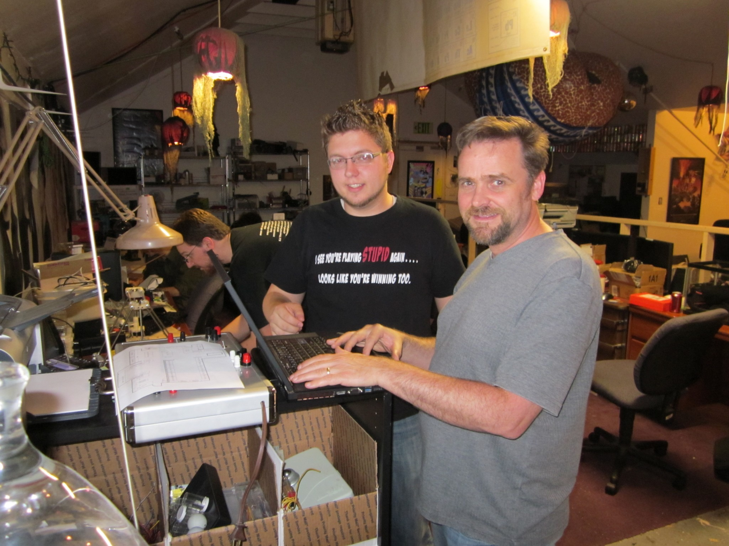

Slide 94
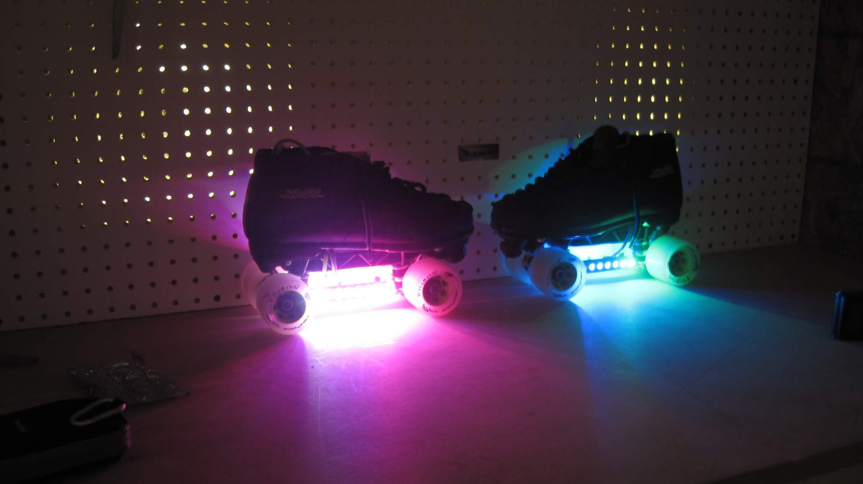

Slide 95
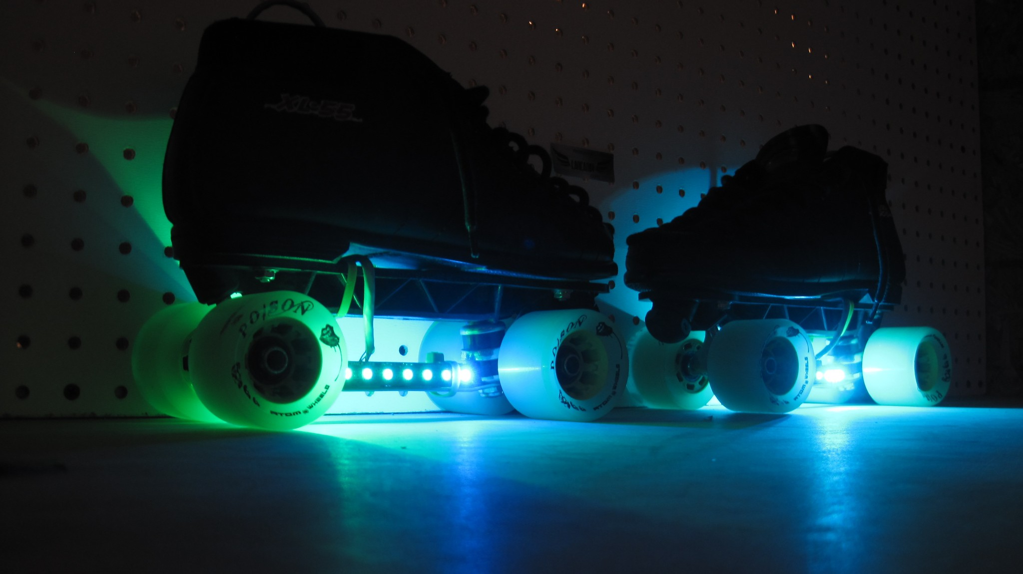

Slide 96
Stay in contact:

Slide 97
Stay in contact:
.: Easy
Facebook / Google Plus

Slide 98
Stay in contact:
.: Easy
Facebook / Google Plus
.: Medium
IRC: Freenode is free
Yahoo Groups, Google Groups, etc

Slide 99
Stay in contact:
.: Easy
Facebook / Google Plus
.: Medium
IRC: Freenode is free
Yahoo Groups, Google Groups, etc
.: Hard (relative)
Setup your own website, Mailing lists, etc

Slide 100
Define things you may want!

Slide 101
Define things you may want!
.: Stick to your core!
<< Don't set up a huge workshop if everyone wants to do electronics and software.

Slide 102
Define things you may want!
.: Stick to your core!
<< Don't set up a huge workshop if everyone wants to do electronics and software.
.: Dirty Space vs Clean Space
<< Keep the electronics / hang out / collaborative areas clean, and the away from the dirty areas like a workshop.

Slide 103
Define things you may want!
.: Stick to your core!
<< Don't set up a huge workshop if everyone wants to do electronics and software.
.: Dirty Space vs Clean Space
<< Keep the electronics / hang out / collaborative areas clean, and the away from the dirty areas like a workshop.
.: Power Requirements
<< If you only have 40 amps of power, you aren't going to run 20 computers, an AC unit or two, and the soldering stations.

Slide 104
Define things you may want!
.: Stick to your core!
<< Don't set up a huge workshop if everyone wants to do electronics and software.
.: Dirty Space vs Clean Space
<< Keep the electronics / hang out / collaborative areas clean, and the away from the dirty areas like a workshop.
.: Power Requirements
<< If you only have 40 amps of power, you aren't going to run 20 computers, an AC unit or two, and the soldering stations.
.: Internet
<< This might actually be something you NEED. Don't forget router, switches, etc.

Slide 105
Define things you may want!
.: Stick to your core!
<< Don't set up a huge workshop if everyone wants to do electronics and software.
.: Dirty Space vs Clean Space
<< Keep the electronics / hang out / collaborative areas clean, and the away from the dirty areas like a workshop.
.: Power Requirements
<< If you only have 40 amps of power, you aren't going to run 20 computers, an AC unit or two, and the soldering stations.
.: Internet
<< This might actually be something you NEED. Don't forget router, switches, etc.
.: Future growth
<< What kinds of things do you want in the future.

Slide 106


Slide 107
Things that every space will want:

Slide 108
Things that every space will want:
.: Access to food
(you need to eat, you will forget to bring food)

Slide 109
Things that every space will want:
.: Access to food
(you need to eat, you will forget to bring food)
.: Lounge Area
(chillout space. sometimes you need a break)

Slide 110
Things that every space will want:
.: Access to food
(you need to eat, you will forget to bring food)
.: Lounge Area
(chillout space. sometimes you need a break)
.: Bathrooms
(must. avoid. jokes.)

Slide 111
Things that every space will want:
.: Access to food
(you need to eat, you will forget to bring food)
.: Lounge Area
(chillout space. sometimes you need a break)
.: Bathrooms
(must. avoid. jokes.)
.: Organization
(contact methods, meetings, physical organization)

Slide 112
Things that every space will want:
.: Access to food
(you need to eat, you will forget to bring food)
.: Lounge Area
(chillout space. sometimes you need a break)
.: Bathrooms
(must. avoid. jokes.)
.: Organization
(contact methods, meetings, physical organization)
.: Legal Info
(Contact a lawyer. The brave could contact the internet)
(You will likely want waivers, basic legal entity, etc)

Slide 113
Legal Considerations

Slide 114
Legal Considerations
.: TALK TO A LAWYER:
<< I AM NOT A LAWYER.

Slide 115
Legal Considerations
.: TALK TO A LAWYER:
<< I AM NOT A LAWYER.
.: Not every group will need to consult a lawyer.

Slide 116
Legal Considerations
.: TALK TO A LAWYER:
<< I AM NOT A LAWYER.
.: Not every group will need to consult a lawyer.
.: You can register most businesses online:
osbr.utah.gov

Slide 117
Legal Considerations
.: TALK TO A LAWYER:
<< I AM NOT A LAWYER.
.: Not every group will need to consult a lawyer.
.: You can register most businesses online:
osbr.utah.gov
.: There are benefits to setting up under a legal entity:

Slide 118
Legal Considerations
.: TALK TO A LAWYER:
<< I AM NOT A LAWYER.
.: Not every group will need to consult a lawyer.
.: You can register most businesses online:
osbr.utah.gov
.: There are benefits to setting up under a legal entity:
<< 401(c)(3) - A federal non-profit. Donations can be written off on donators taxes.
<< Helps mitigate liability
<< Protects the entire group

Slide 119


Slide 120


Slide 121
Potential Hackerspace Locations

Slide 122
Potential Hackerspace Locations
.: Temporary Locations
(not 24/7, maybe an unused room for weekly meetings)
<< Work. Extra room?, Conference Room?
<< Schools
<< Apartment / Condo Clubhouse
<< Coffee Shop / Deli / etc
<< Other hackerspaces / clubs / groups
<< MakeSLC ran out of HackSLC for almost 6 months until we moved to Provo

Slide 123
Potential Hackerspace Locations
.: Temporary Locations
(not 24/7, maybe an unused room for weekly meetings)
<< Work. Extra room?, Conference Room?
<< Schools
<< Apartment / Condo Clubhouse
<< Coffee Shop / Deli / etc
<< Other hackerspaces / clubs / groups
<< MakeSLC ran out of HackSLC for almost 6 months until we moved to Provo
.: Permanent Locations
<< Ask EVERYONE
<< Craigslist / KSL
<< Realty Companies

Slide 124
You found a space! Awesome!

Slide 125


Slide 126


Slide 127


Slide 128


Slide 129


Slide 130


Slide 131


Slide 132


Slide 133


Slide 134


Slide 135


Slide 136
You found a space! Awesome!
.: Before you sign a lease talk to a lawyer.

Slide 137
You found a space! Awesome!
.: Before you sign a lease talk to a lawyer.
<< At a bare minimum READ EVERYTHING

Slide 138
You found a space! Awesome!
.: Before you sign a lease talk to a lawyer.
<< At a bare minimum READ EVERYTHING
<< are you personally liable for the lease?

Slide 139
You found a space! Awesome!
.: Before you sign a lease talk to a lawyer.
<< At a bare minimum READ EVERYTHING
<< are you personally liable for the lease?
<< what exactly does this lease entail?

Slide 140
You found a space! Awesome!
.: Before you sign a lease talk to a lawyer.
<< At a bare minimum READ EVERYTHING
<< are you personally liable for the lease?
<< what exactly does this lease entail?
.: Is the space up to code?

Slide 141
You found a space! Awesome!
.: Before you sign a lease talk to a lawyer.
<< At a bare minimum READ EVERYTHING
<< are you personally liable for the lease?
<< what exactly does this lease entail?
.: Is the space up to code?
<< (electrical, assembly, fire, etc)

Slide 142
You found a space! Awesome!
.: Before you sign a lease talk to a lawyer.
<< At a bare minimum READ EVERYTHING
<< are you personally liable for the lease?
<< what exactly does this lease entail?
.: Is the space up to code?
<< (electrical, assembly, fire, etc)
<< can you be held liable if it's not?

Slide 143
You found a space! Awesome!
.: Before you sign a lease talk to a lawyer.
<< At a bare minimum READ EVERYTHING
<< are you personally liable for the lease?
<< what exactly does this lease entail?
.: Is the space up to code?
<< (electrical, assembly, fire, etc)
<< can you be held liable if it's not?
<< are there other codes that just apply to your group?

Slide 144
You found a space! Awesome!
.: Before you sign a lease talk to a lawyer.
<< At a bare minimum READ EVERYTHING
<< are you personally liable for the lease?
<< what exactly does this lease entail?
.: Is the space up to code?
<< (electrical, assembly, fire, etc)
<< can you be held liable if it's not?
<< are there other codes that just apply to your group?
<< should you care? (probably)

Slide 145
You found a space! Awesome!
.: Before you sign a lease talk to a lawyer.
<< At a bare minimum READ EVERYTHING
<< are you personally liable for the lease?
<< what exactly does this lease entail?
.: Is the space up to code?
<< (electrical, assembly, fire, etc)
<< can you be held liable if it's not?
<< are there other codes that just apply to your group?
<< should you care? (probably)
.: Liability Waivers?

Slide 146
You found a space! Awesome!
.: Before you sign a lease talk to a lawyer.
<< At a bare minimum READ EVERYTHING
<< are you personally liable for the lease?
<< what exactly does this lease entail?
.: Is the space up to code?
<< (electrical, assembly, fire, etc)
<< can you be held liable if it's not?
<< are there other codes that just apply to your group?
<< should you care? (probably)
.: Liability Waivers?
<< probably should have them

Slide 147
You found a space! Awesome!
.: Before you sign a lease talk to a lawyer.
<< At a bare minimum READ EVERYTHING
<< are you personally liable for the lease?
<< what exactly does this lease entail?
.: Is the space up to code?
<< (electrical, assembly, fire, etc)
<< can you be held liable if it's not?
<< are there other codes that just apply to your group?
<< should you care? (probably)
.: Liability Waivers?
<< probably should have them
<< might not need them if you are just using computers

Slide 148
You found a space! Awesome!
.: Before you sign a lease talk to a lawyer.
<< At a bare minimum READ EVERYTHING
<< are you personally liable for the lease?
<< what exactly does this lease entail?
.: Is the space up to code?
<< (electrical, assembly, fire, etc)
<< can you be held liable if it's not?
<< are there other codes that just apply to your group?
<< should you care? (probably)
.: Liability Waivers?
<< probably should have them
<< might not need them if you are just using computers
<< but you probably want them anyways

Slide 149
Important randoms

Slide 150
Important randoms
.: Make a layout / plan for the space
<< be prepared to refactor the layout

Slide 151
Important randoms
.: Make a layout / plan for the space
<< be prepared to refactor the layout
.: Listen to everyone
<< hold regular meetings
<< vote on important things

Slide 152
Important randoms
.: Make a layout / plan for the space
<< be prepared to refactor the layout
.: Listen to everyone
<< hold regular meetings
<< vote on important things
.: Maintain a SUDO group

Slide 153
Important randoms
.: Make a layout / plan for the space
<< be prepared to refactor the layout
.: Listen to everyone
<< hold regular meetings
<< vote on important things
.: Maintain a SUDO group
.: Involve everyone
<< group projects
<< group outings, visit other groups, see cool stuff

Slide 154
Important randoms
.: Make a layout / plan for the space
<< be prepared to refactor the layout
.: Listen to everyone
<< hold regular meetings
<< vote on important things
.: Maintain a SUDO group
.: Involve everyone
<< group projects
<< group outings, visit other groups, see cool stuff
.: Always improve the group / space

Slide 155
Important randoms
.: Make a layout / plan for the space
<< be prepared to refactor the layout
.: Listen to everyone
<< hold regular meetings
<< vote on important things
.: Maintain a SUDO group
.: Involve everyone
<< group projects
<< group outings, visit other groups, see cool stuff
.: Always improve the group / space
.: Expand only when absolutely needed

Slide 156


Slide 157


Slide 158


Slide 160
What have our (HackSLC / TheTransistor) Pitfalls and Rewards been?

Slide 161
What have our (HackSLC / TheTransistor) Pitfalls and Rewards been?
(I'm a bad-news first kind of a person, so let's do the pitfalls first.)

Slide 162
Pitfalls

Slide 163


Slide 164
Pitfalls
.: Not sticking to our own rules can cause anarchy.
<< Sometimes this is nice.
<< Most of the time it's just unwanted drama.

Slide 165
Pitfalls
.: Not listening to members
<< They get upset
<< They leave the group

Slide 166


Slide 167
Pitfalls
.: Not including everyone
<< Members feel left out, bored
<< They leave the group

Slide 168


Slide 169
Pitfalls
.: Not sticking to core needs
<< If you focus on fringe wants, less will get done.
<< It's harder to complete core projects if the space is configured for something else.

Slide 170
Pitfalls
.: Not sticking to core needs
EXAMPLE:

Slide 171
Pitfalls
.: Not sticking to core needs
EXAMPLE:
The situation:
<< Our members wanted a large workshop area, so we dedicated about 1/3rd of the space to that.
<< The space was rarely used.
<< About 90% of the what the members wanted was electronics and software-based.

Slide 172
Pitfalls
.: Not sticking to core needs
EXAMPLE:
The situation:
<< Our members wanted a large workshop area, so we dedicated about 1/3rd of the space to that.
<< The space was rarely used.
<< About 90% of the what the members wanted was electronics and software-based.
In response:
<< We scaled the workshop back to about 5-10% of the space.
<< We added a ton of personal desk space
<< We upgraded the network / servers
<< We allocated more space to electronics

Slide 173
Pitfalls
.: Not sticking to core needs
EXAMPLE:
The situation:
<< Our members wanted a large workshop area, so we dedicated about 1/3rd of the space to that.
<< The space was rarely used.
<< About 90% of the what the members wanted was electronics and software-based.
In response:
<< We scaled the workshop back to about 5-10% of the space.
<< We added a ton of personal desk space
<< We upgraded the network / servers
<< We allocated more space to electronics
The result:
<< Members had a better time! More projects got done, and more members joined.

Slide 174

Pitfalls
.: Not sticking to core needs
EXAMPLE:
The Lesson:
<< If you don't stick to your core needs, you're gonna have a bad time.

Slide 175
Pitfalls
.: Trying to please everyone
<< Every member needs a voice, but you need to focus on the needs of the group
<< Try to keep everyone happy, but realize you are going to have to upset some members.

Slide 176
Rewards

Slide 177
Rewards
.: Everyone is happy, has a good time

Slide 178
Rewards
.: Everyone is happy, has a good time
.: Projects get completed

Slide 179
Rewards
.: Everyone is happy, has a good time
.: Projects get completed
.: New ideas are formed

Slide 180
Rewards
.: Everyone is happy, has a good time
.: Projects get completed
.: New ideas are formed
.: Software, Hardware is developed and shared

Slide 181
Rewards
.: Everyone is happy, has a good time
.: Projects get completed
.: New ideas are formed
.: Software, Hardware is developed and shared
.: The entire group contributes to projects

Slide 182


Slide 183


Slide 184


Slide 185


Slide 186


Slide 187


Slide 188
Additional Resources
.: Hackerspace design patterns
<< http://hackerspaces.org/wiki/Design_Patterns
.: Utah One Stop Business Registration
<< http://osbr.utah.gov
.: Google / The Internet
<< The internet is your friend. Tons of resources.
.: Other Hackerspaces
<< Generally VERY helpful. Contact them.

Slide 189

QUESTIONS?

